Slide 1
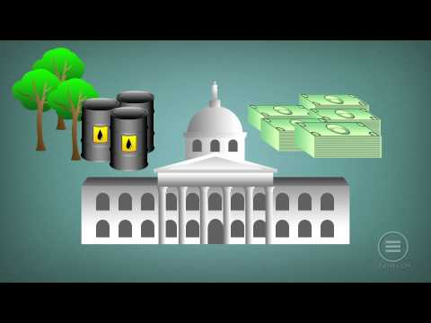
Economic Systems
4 Types

Slide 2
How are the needs and want for resources in this system increasing or decreasing the quality of life for people staking part in this system?
How does this system cause potential conflict?
How can this system allow for compromise and negotiation?

Slide 3
How are the needs and want for resources in this system increasing or decreasing the quality of life for people staking part in this system?
How does this system cause potential conflict?
How can this system allow for compromise and negotiation?

Slide 4
How are the needs and want for resources in this system increasing or decreasing the quality of life for people staking part in this system?
How does this system cause potential conflict?
How can this system allow for compromise and negotiation?

Slide 5
How are the needs and want for resources in this system increasing or decreasing the quality of life for people staking part in this system?
How does this system cause potential conflict?
How can this system allow for compromise and negotiation?

Slide 6
How are the needs and want for resources in this system increasing or decreasing the quality of life for people staking part in this system?
How does this system cause potential conflict?
How can this system allow for compromise and negotiation?

