Slide 1
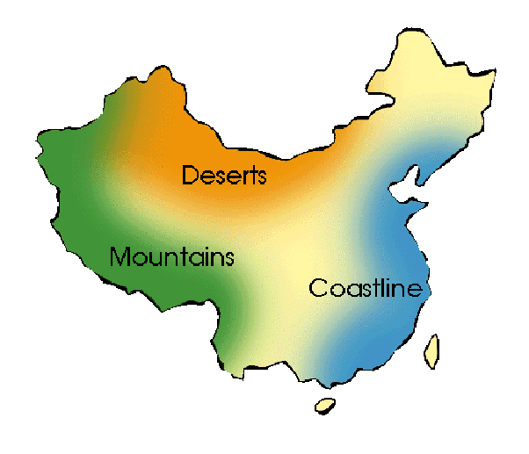
Where would you settle if you were starting a town in China?

Slide 2
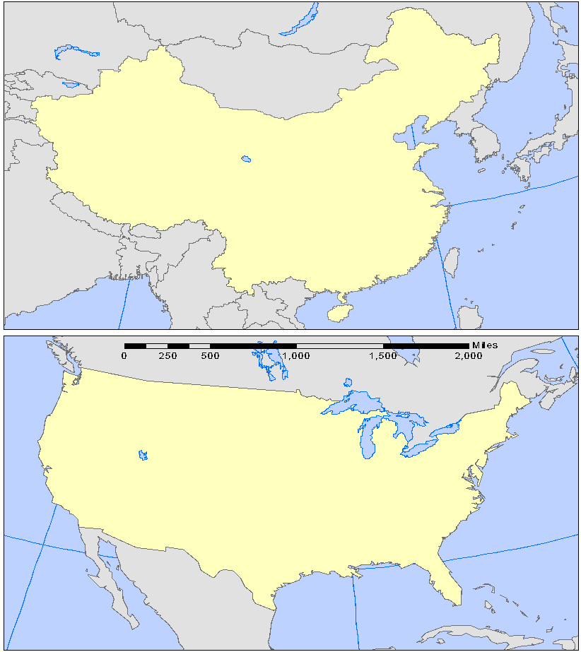
Geography of China
China is nearly the same size as the United States

Slide 3
Comparison of US and China
 | China | United States
Size | 3.7 million square miles | 3.6 million square miles
Main physical barrier | Himalayas | Rockies
Main River | Yangtze / East - West | Mississippi / North – South
Population | East Coast | East Coast

Slide 4
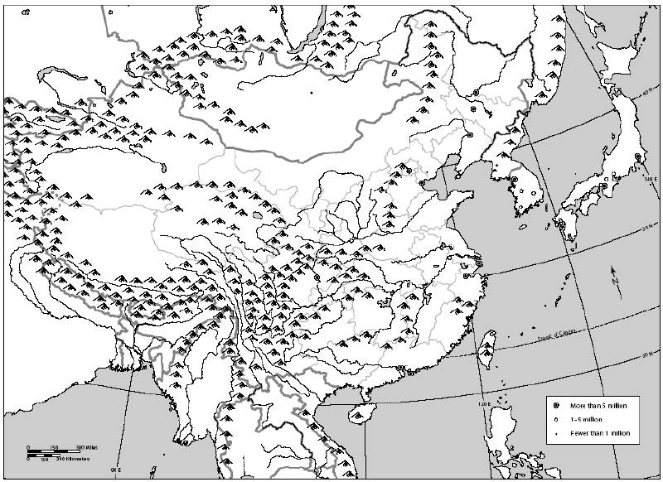
Natural Barriers of China
Chinese thought they were alone in the world, except for the Mongols to the North, until 200 BCE.
Amur River
Altai Mts.
Greater Khingan
Manchurian Plain
Tian Shan
North China Plain
Sea of Japan
Gobi Desert
Tarim Basin
Taklamakan Desert
Kunlun Shan
Yellow Sea
Tibetan Plateau
Huang-He River
Himalayan Mts.
Yangtze River
Xi River
Pacific Ocean
South China Sea

Slide 5
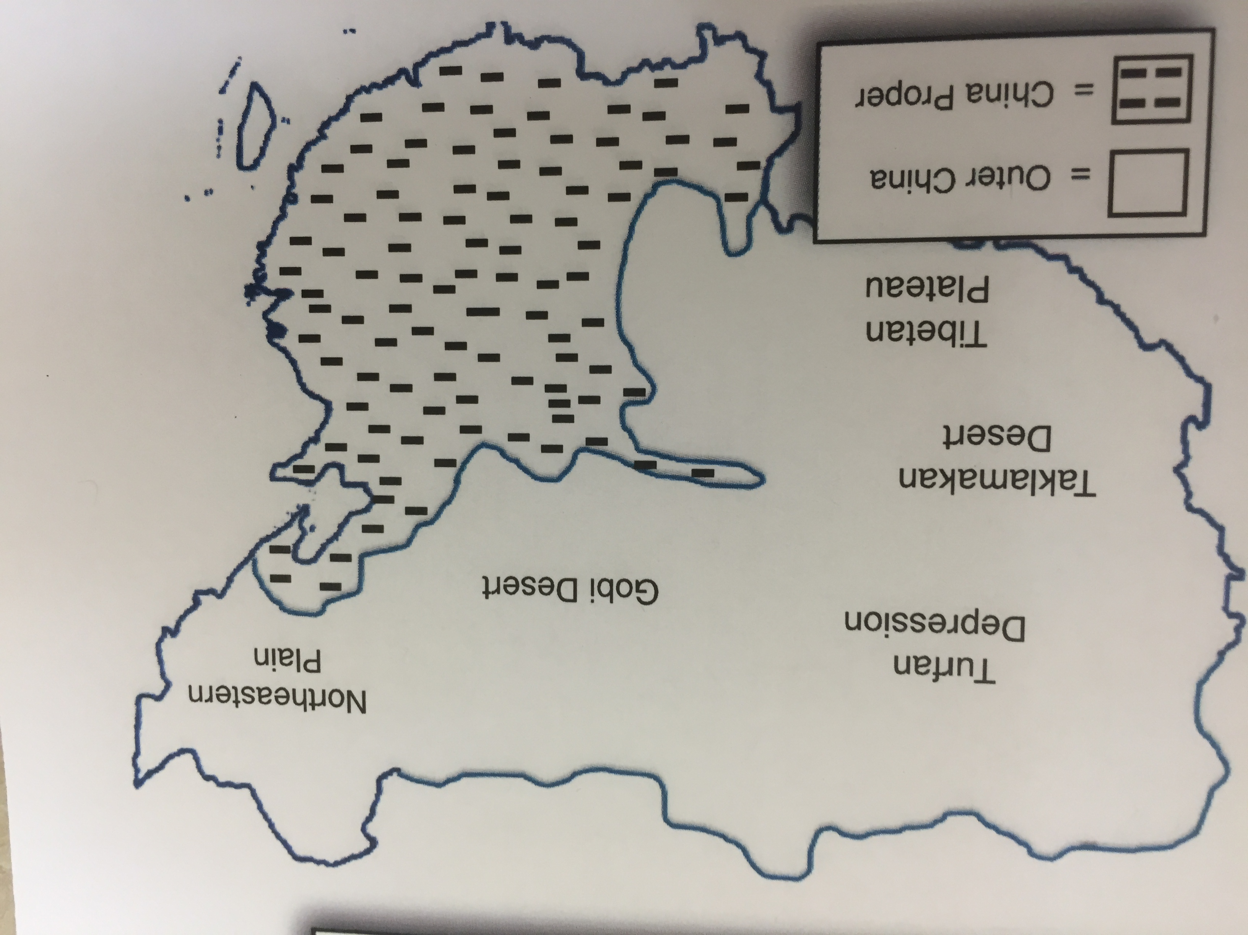

Slide 6
The Tibetan Plateau

Slide 7
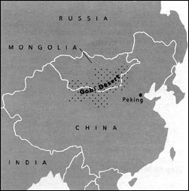
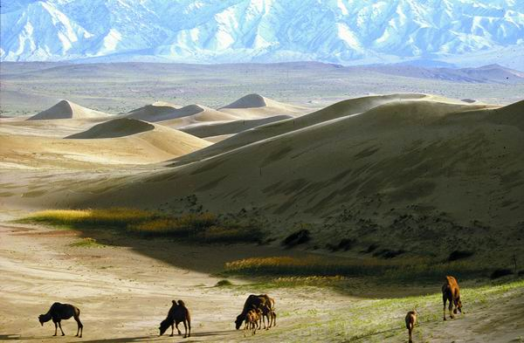
Northern China
Gobi Desert: One of the world’s largest deserts. There are some oases in the Gobi.

Slide 8
Northern China
Manchurian Plain: One of the world’s largest agricultural regions.

Slide 9
Western China
Taklamakan Desert: Name means “if you go in, you won’t come out”.
World’s second largest desert
Hazards:
Poisonous snakes
Sandstorms
Freezing nights
Little water

Slide 10
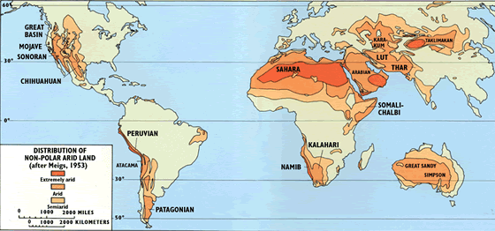
WORLD’S DESERTS

Slide 11
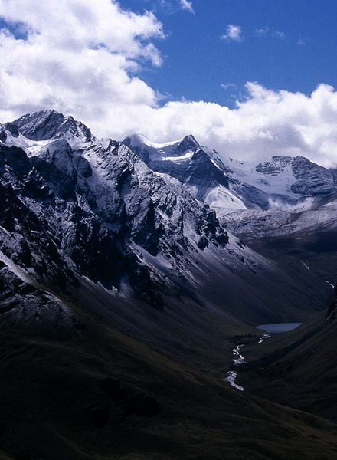
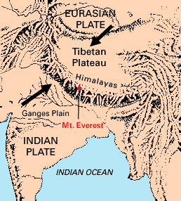
Southern China
Himalayan Mountains:
World’s highest mountain range
Home to Mount Everest

Slide 12
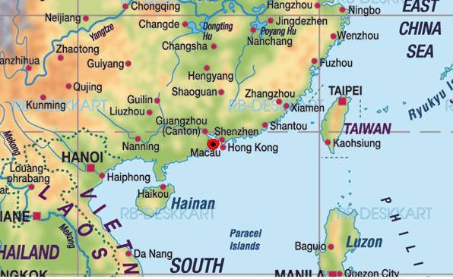
Eastern China
Coastal China.
Pacific Ocean
Yellow Sea
China Sea

Slide 13
Rivers of China
The rivers of China were known as China’s Great Sorrow, because every year they would flood and the towns along them would have to be rebuilt.

Slide 14
Huang He (Yellow River)
About 3,000 miles long (about the distance from New York to California)
China’s earliest people lived along this river because the ground is very fertile.

Slide 15
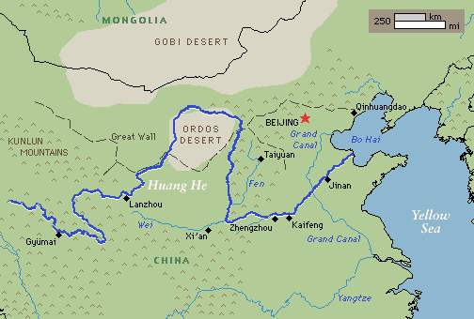

Slide 16
Yangtze River (Long River)
About 4,000 miles long
River flows through some of China’s best farmland
People have always built their homes up high above the river to prevent homes being damaged in annual flooding.

Slide 17
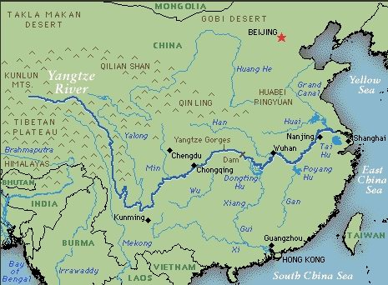

Slide 18
SHARE:
1. What is the capital of China? __________________________________________________________
2. What ocean borders China on the east? _______________________________________________
3. What sea is on China's southeast border? _______________________________________________
4. What river flows by Shanghai?__________________________________________________________
5. Which major river crosses the Great Wall? _______________________________________________
6. In which part of China is its capital, Beijing: NE, NW, SE, or SW? ____________________________
7. Name two countries that border China on the northeast: ____________________ and ____________________
8. What is the name of the major river that flows by Shanghai? ______________________________
9. If you wanted to travel from Guangzhou to Shanghai, in which direction would you head? ____________________
10. Roughly how many miles is it from Beijing to Shanghai: 6 miles, 60 miles, 600 miles, 6,000 miles, or 60,000 miles? _____________________________________________________________________

