Slide 1
Warm-up
Get out your Citizenship notes from yesterday and complete the three sentences on the back. You should use supporting information in your answer. These should be written in complete sentences!

Slide 2
Citizenship

Slide 3
What is a citizen?
~A person from a city, state or country who has the rights and privileges of a freeman. A native or naturalized person who owes allegiance to a government and is entitled to protection from it.
What are the requirements, rights and responsibilities of a citizen?

Slide 4
What have been the requirements for citizenship throughout time?

Slide 5
DIRECTIONS
As you examine the following 6 pictures, infer what requirement for citizenship is being represented by the picture. Write your guesses on your handout.

Slide 6
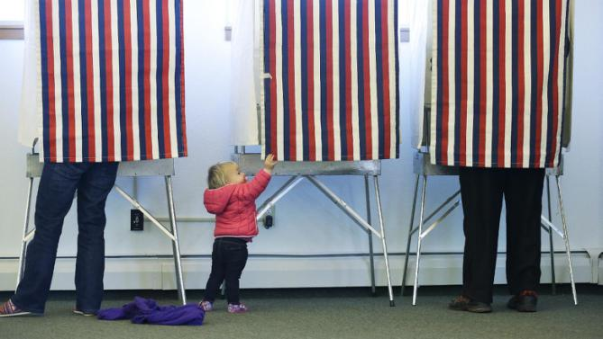
adult to participate

Slide 7
free

Slide 8
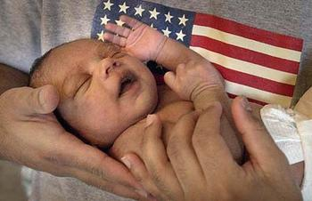
Native born

Slide 9
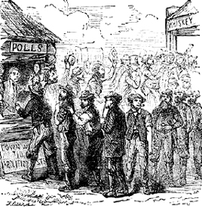
Male

Slide 10
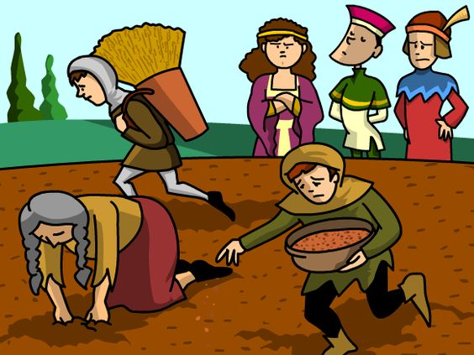
upper class

Slide 11
land-owning

Slide 12
Which factors eliminated most people from citizenship in ancient civilizations?
children
slaves
foreign born
women
lower class
non-property owning

Slide 13
What were/are the rights and responsibilities of citizens?

Slide 14
DIRECTIONS
As you examine the following 6 pictures, infer what rights and responsibilities come with citizenship as represented by each image. Write your guesses on your handout.

Slide 15
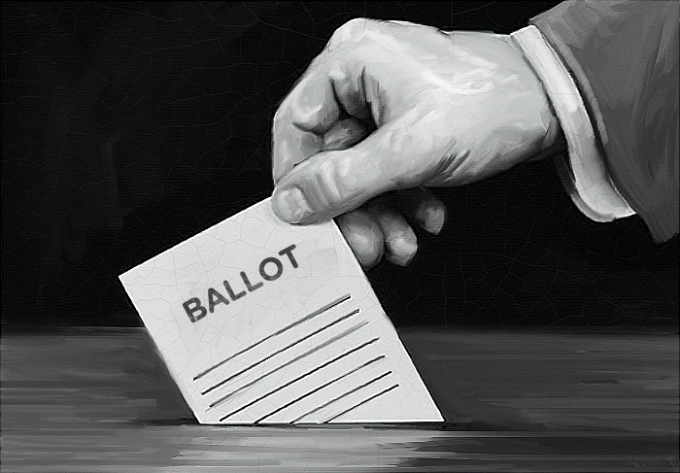
voting

Slide 16
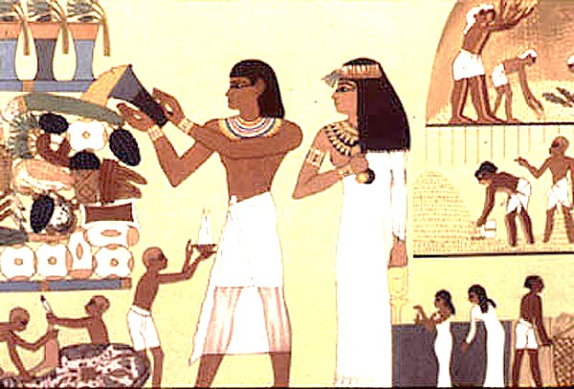
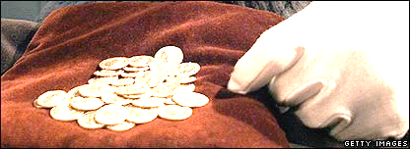
taxes

Slide 17
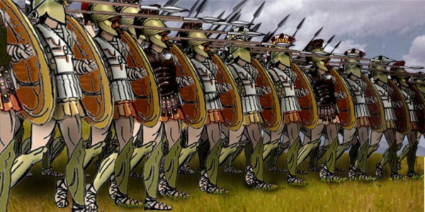
military service

Slide 18
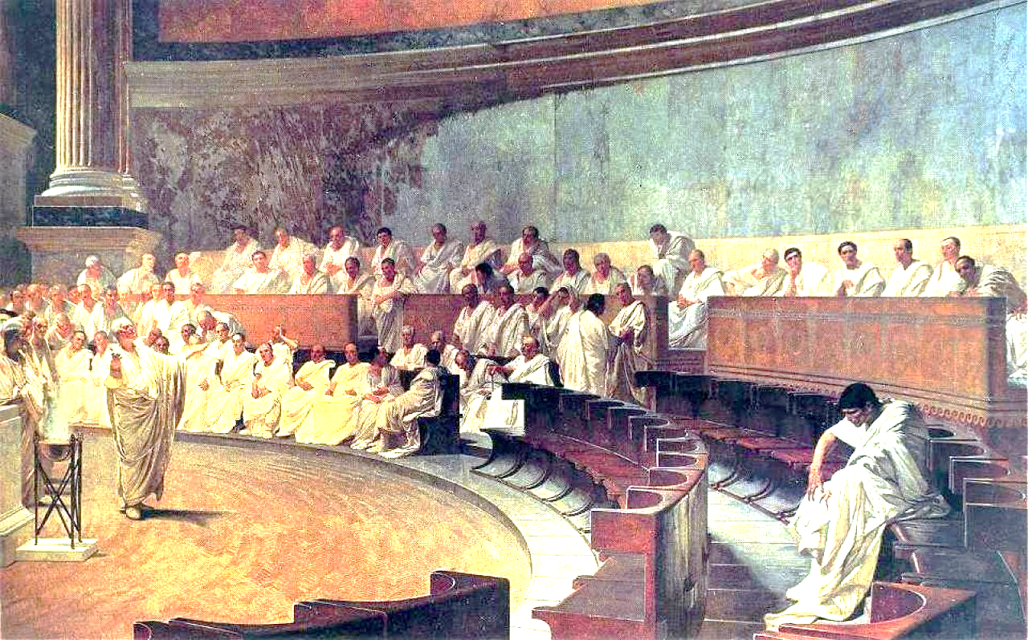
participate in government

Slide 19
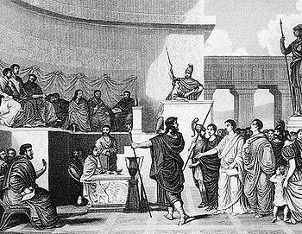
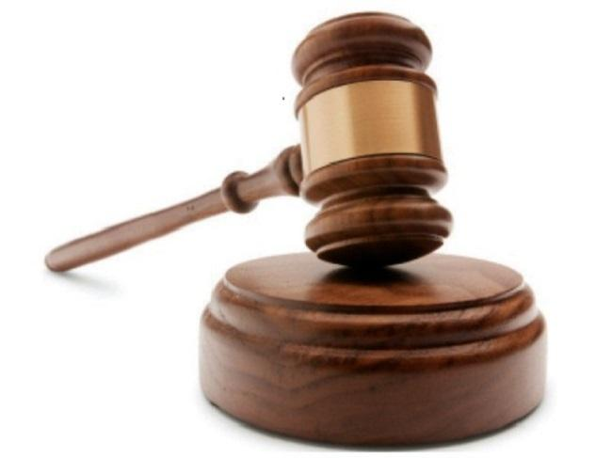
right to trials

Slide 20
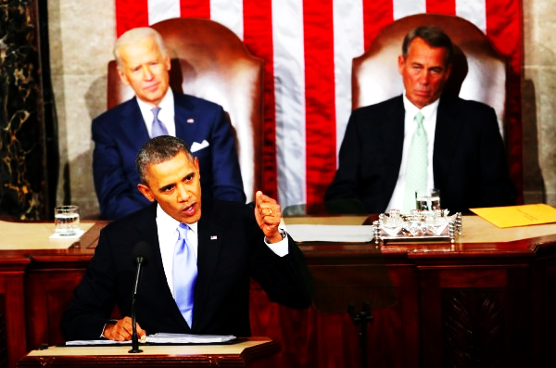
run for office

Slide 21
Citizenship: bringing it all together!
Requirements
Loyalty
Rights
Responsibilities

Slide 22
