Slide 1
CULTURE AND LEGACY OF ANCIENT GREECE

Slide 2
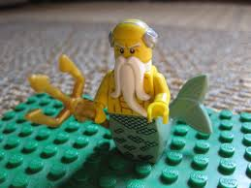
Station 1 The Gods and Myths
What are the purposes of myths in Greek culture?
Myths were used to explain the world around them.
2. Greek gods were known to be divine. Using the context clues of the reading, what do you think is a good synonym for the word divine?
God-like, holy .

Slide 3
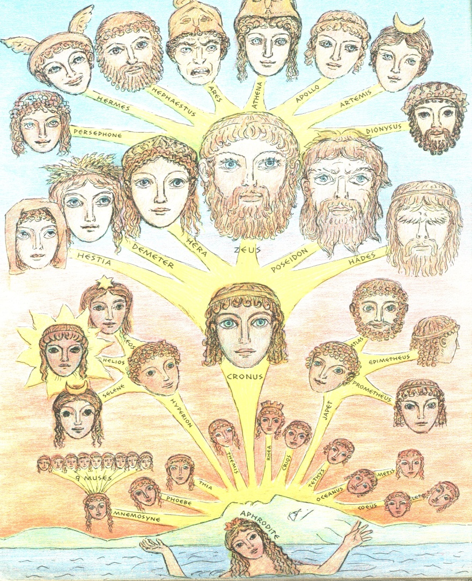
Station 2 City-States and the Gods
3. What does every city-state in Ancient Greece have? (give an example)
Every city-state had a god or goddess to protect it (and temples too). Athens had Athena.
4. How do we know about the culture and gods in Ancient Greece?
We know this from what has passed down from word of mouth, fables, songs, poetry, and art.

Slide 4
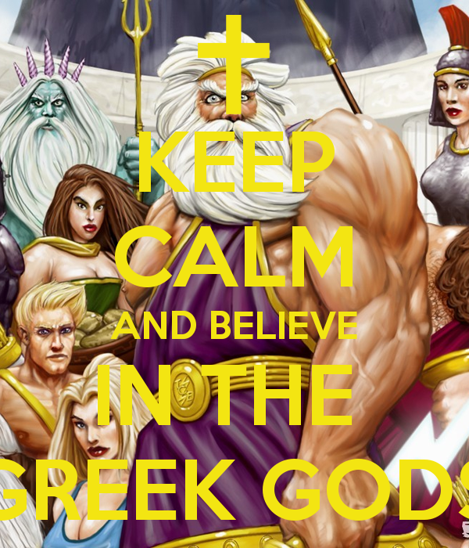
Station 3 Honoring the Gods
5. Why did the Ancient Greeks spend so much time honoring the gods?
They believed an angry god caused trouble; they wanted to ensure the gods were happy and satisfied.
6. How were the original Ancient Greek Olympics different than our present-day Olympics?
Ancient Greeks participated naked
the first Olympics had only foot-races
In Ancient Greece, the Olympics was done to honor the gods (today is more for national or individual sport)

Slide 5
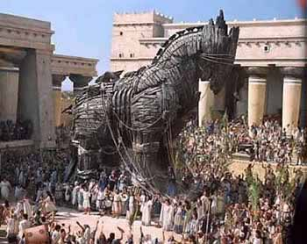
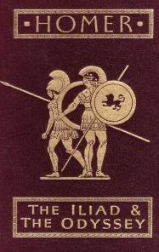
Station 4 Greek Literature
7. What famous writers were there in Ancient Greece, what did each of them write?
a. Homer wrote epic poems like the Iliad and the Odyssey
b. Aesop wrote fables like the “Tortoise and the Hare.”

Slide 6
Station 5 Greek Theater and Drama
8. What two types of drama were invented by the Greeks? (define each)
a. Tragedy: serious drama that shows the downfall of a main character (usually end sad)
b. Comedy: less serious work, often makes fun of politics, important people, and ideas of the time, usually ended happily)

Slide 7
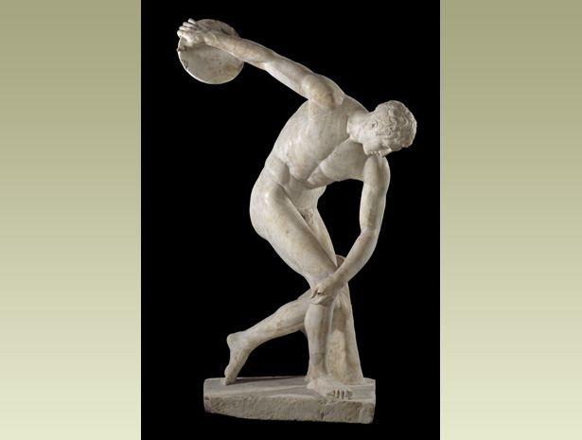
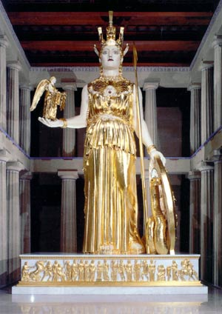
Station 6 Greek Art
9. What can we learn from studying Ancient Greek artwork?
Art can’t always be taken at face-value for how Greeks looked since it glorified humans. It also tells us what the Greeks valued in regards to the human form.
10. Who is Phidias, and why is he important to Greek artwork?
Phidias was the Greek sculptor, who made the 30-foot tall statue of Athena made of gold and ivory.

Slide 8
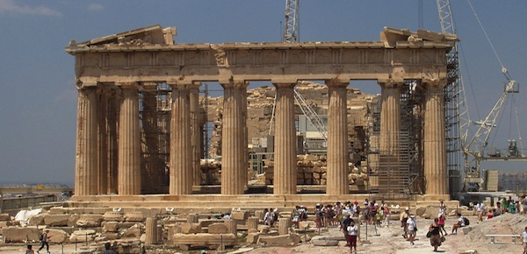
Station 7 Greek Architecture
11. How was architecture like art in Ancient Greece?
There are many different styles
Both were used to honor the gods
Many beautiful works created
12. Which column style do the Romans borrow most often?
Corinthian

Slide 9
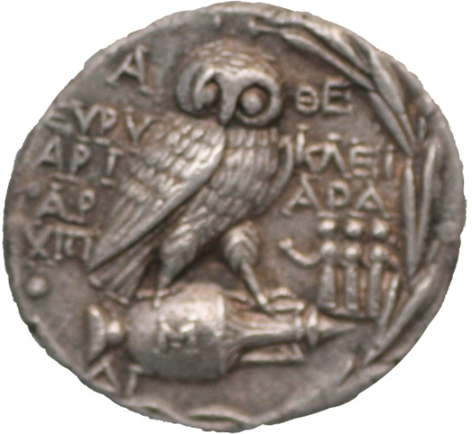
Station 8 History
13. Why did Thucydides use primary resources to write about history?
He believed it was important to back up his findings with eyewitness accounts and documents.
14. Which wars do we learn detailed information about because of the two Ancient Greek historians?
Herodotus = Persian Wars
Thucydides = Peloponnesian Wars

Slide 10
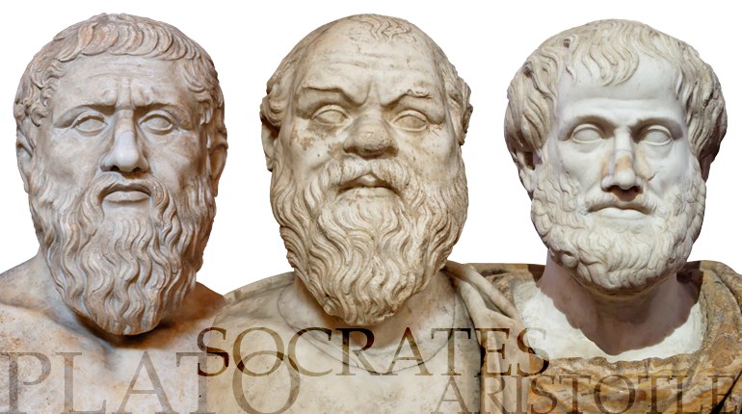
Station 9 Philosophy
15. What did Socrates encourage his students to do?
He encouraged them to question the world around them.
16. After Socrates, which two philosophers emerge, and what do they do to become famous?
a. Plato – one of Socrates’ best students; he started a school of higher learning called “The Academy.”
b. Aristotle – Plato’s brightest student; he invented debating method that followed rules of logic (series of speaking in questions)

Slide 11
Station 10 Science and Technology
17. Six astronomers and mathematicians are listed on this station. Name them and describe what they did to change the world.
a. Erathosthenes – estimated distance around Earth
b. Ptolemy – said Earth was center of universe
c. Aristarchus – estimated size of sun
d. Hypatia – first female mathematician and leader in geometry
e. Archimedes – explained laws of levers and simple machines
f. Euclid – founder of geometry

Slide 12
Bonus Can you answer the riddle of the Sphinx? “What goes on four legs in the morning, on two legs at noon and on three legs in the evening?” The life-cycle of a person.

