Slide 1
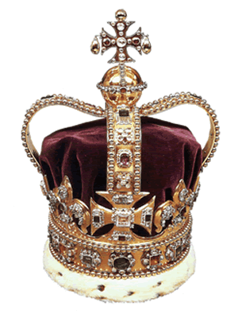
Monarchy
Description: Ruled by one (King or Queen)
Monarchies didn’t last because the nobles got tired of giving the king all of the power and their wealth.

Slide 2
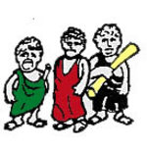
Oligarchy
Description: Rule by a few (usually the rich and powerful or nobles)
Oligarchies didn’t last because populations were growing so fast and the kings couldn’t provide for the people’s needs.

Slide 3
Tyranny
Description: government that is ruled by a harsh leader called a tyrant (like a dictator)
Tyrannies didn’t last because some tyrants were cruel and greedy and didn’t listen to the people.

Slide 4
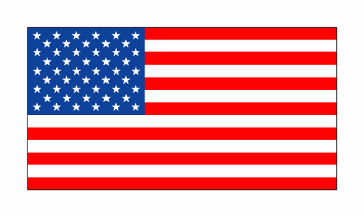
Democracy
Description: government ruled by the people

