Slide 1
Intro to Government - Forms of Government

Slide 2
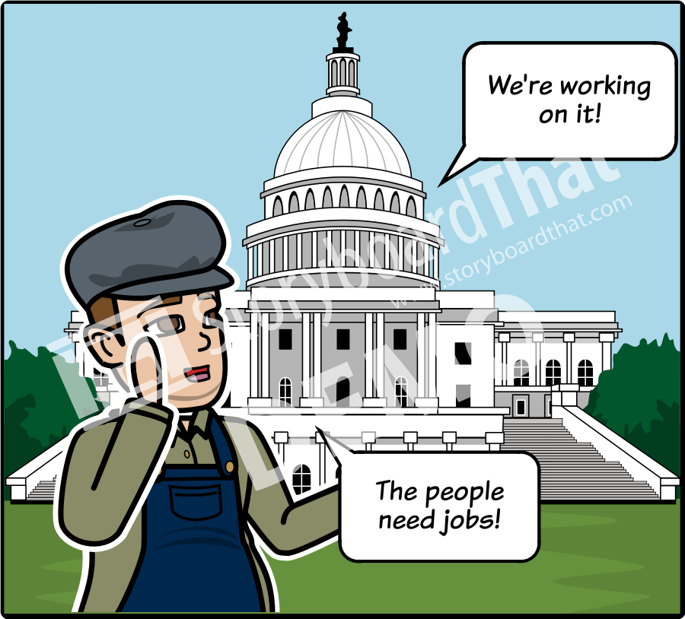
REPRESENTATIVE DEMOCRACY
A representative democracy, sometimes known as a republic, is a form of government where the people vote on their leaders. Leaders listen to the concerns and problems of the people and create laws to solve them.

Slide 3
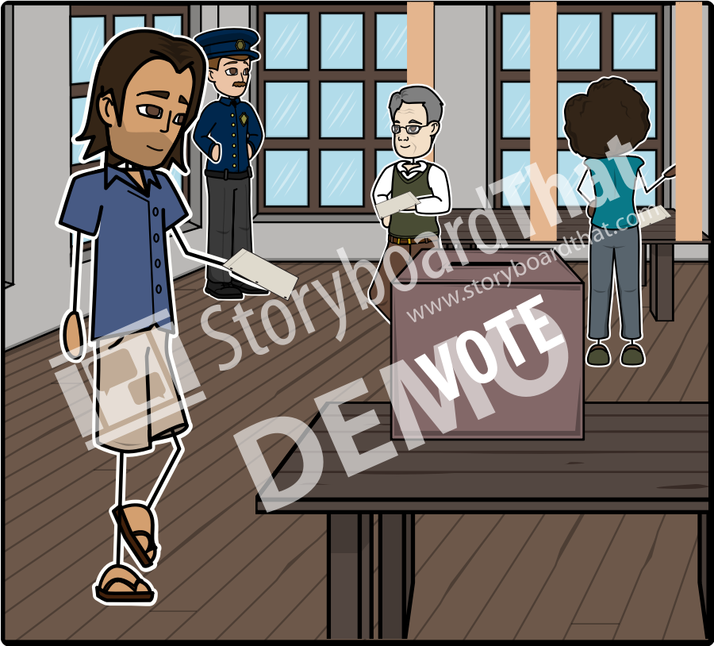
DIRECT DEMOCRACY
A direct democracy is a form of government where the citizens determine how the country should function. A direct democracy has no elected leaders and each citizen has an equal level of power.

Slide 4
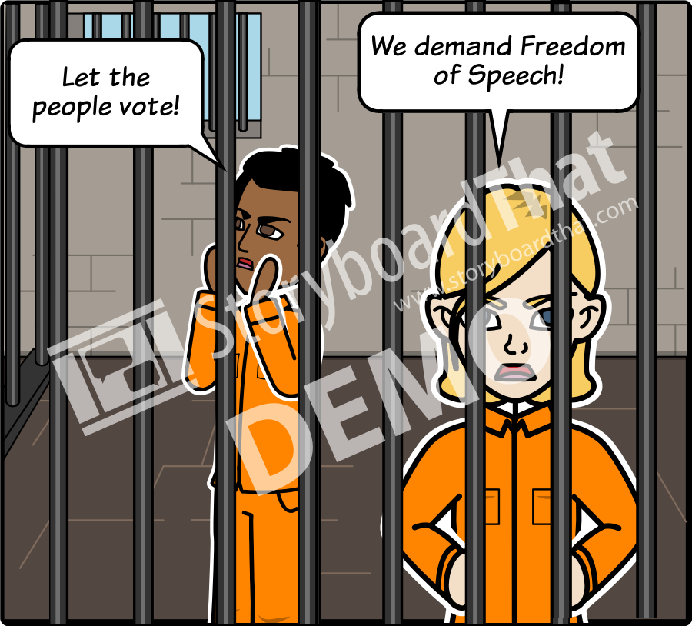
DICTATORSHIP
A dictatorship is a form of government where the power is in the hands of one individual with full authority to enforce and create any laws they desire. Rights and liberties of the citizens are usually suppressed in order to maintain the power of the government.

Slide 5
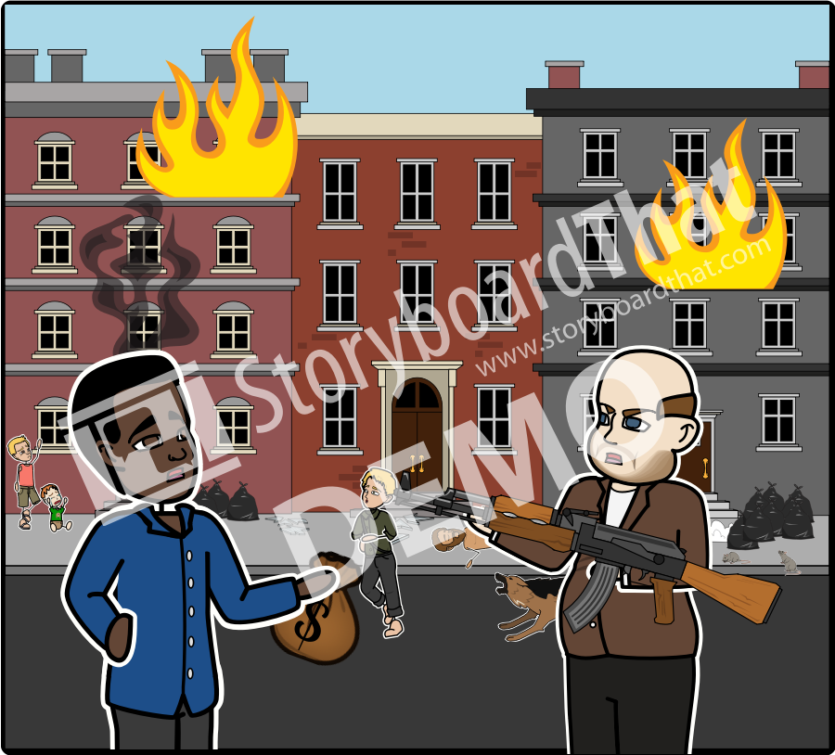
ANARCHY
An anarchy is the state without a government. In an anarchy, there is no law creation or enforcement. An anarchy is typically characterized by violence and disorder.

Slide 6
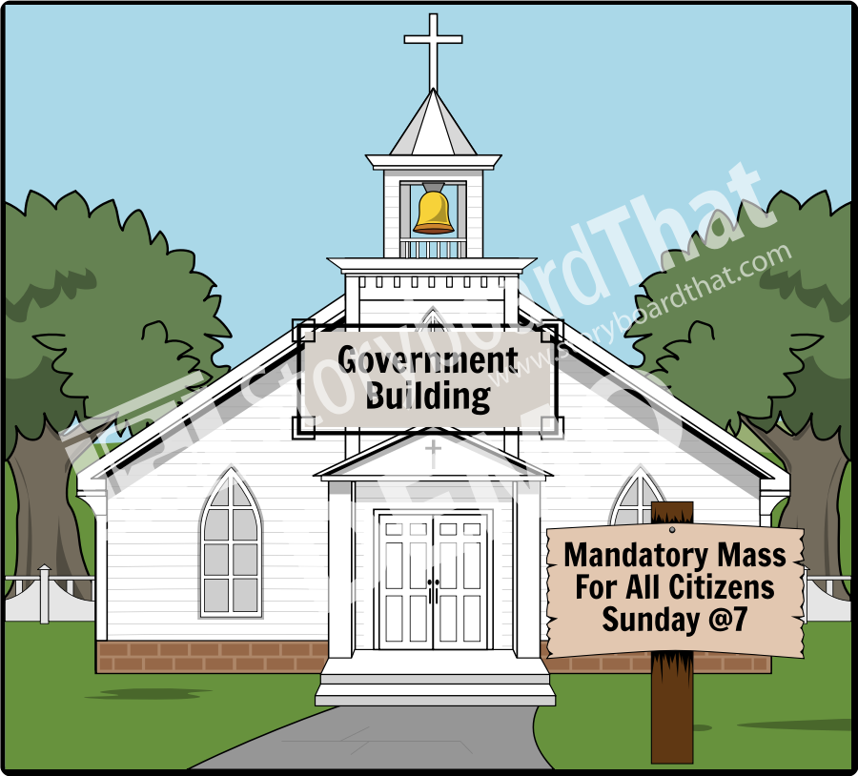
THEOCRACY
A theocracy is any form government centered on a god or gods. A theocracy has a ruling religious authority that oversees the creation and enforcement of laws. Power rests with the religious authority who may or may not give their citizens freedoms.

Slide 7
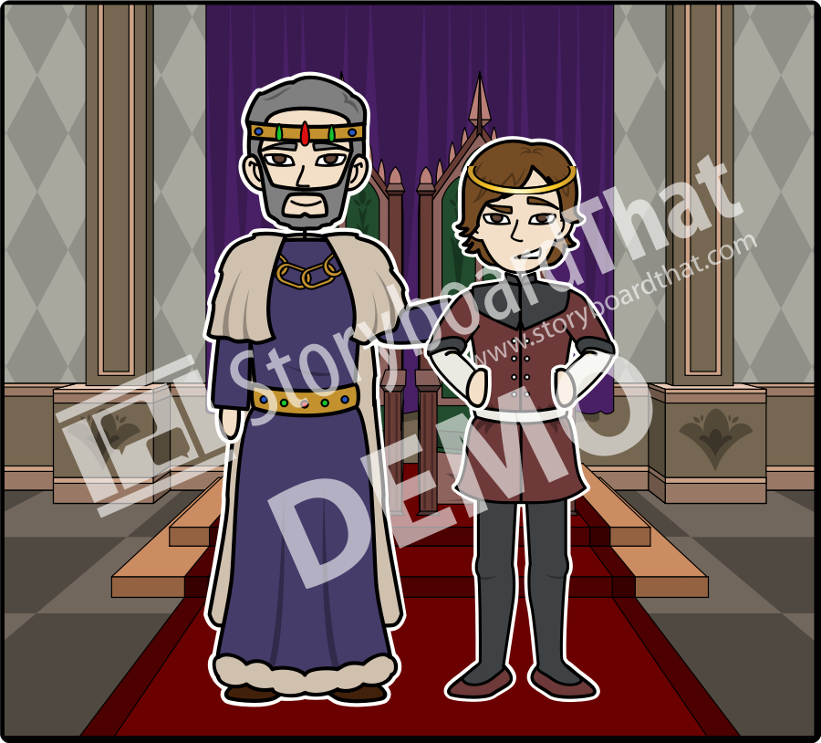
MONARCHY
In a monarchy, a king or queen, "a monarch", rules over the people. Some monarchs have held all of the power, while others have shared their power with other branches of government. A monarch typically comes to power by inheritance. Depending on the monarch, citizens can have numerous rights and privileges, or none at all.

Slide 8
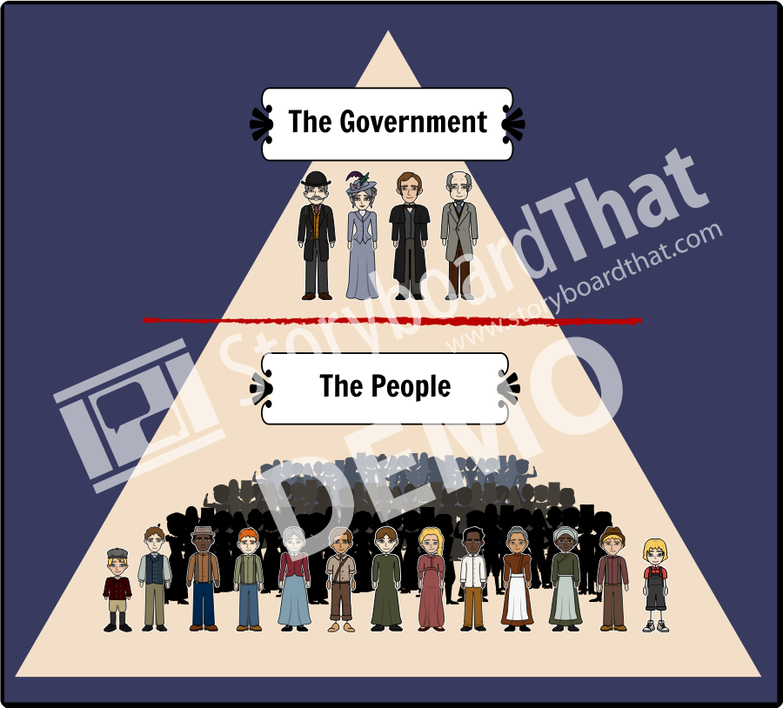
OLIGARCHY
An oligarchy is a form of government where a small group has the power. Historically, oligarchies have consisted of those with significant wealth or military power. The rights of citizens are determined solely by those in the small group.

