Slide 1
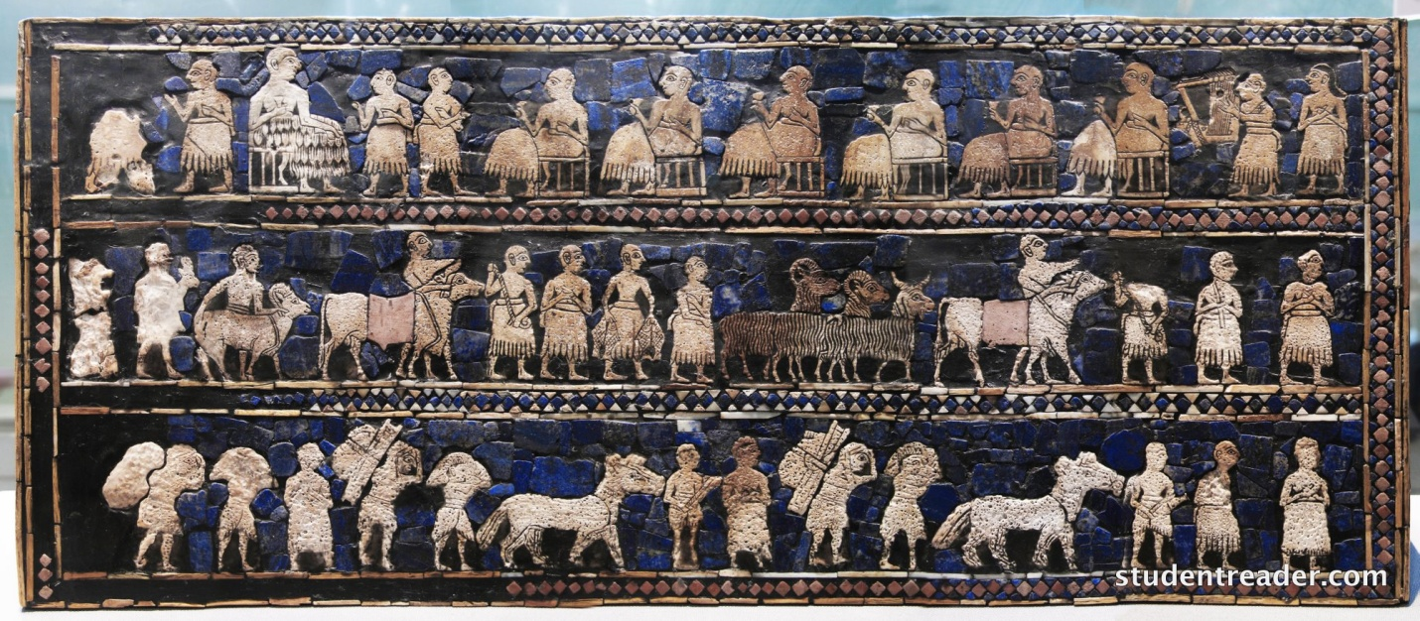
FROM NOMADS TO FARMERS

Slide 2
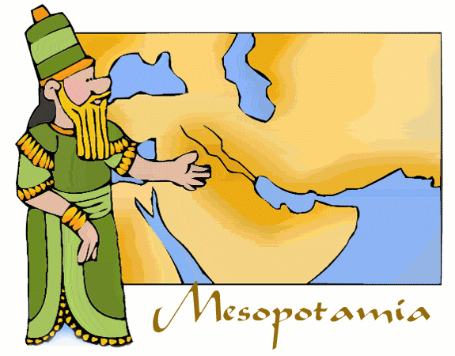
1. The Sumerians were originally hunters and constantly on the move following the herds. They often didn’t know where their next meal would come from, which is a hard way to live.
2. Mesopotamia means “land between the rivers.”
3. It lies between the Tigris and Euphrates Rivers.

Slide 3
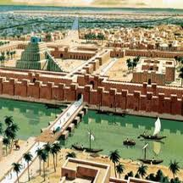
4. Snow from nearby mountains melts causing rivers to rise over the banks and flood the valleys, dumping good dirt on the land.
5. The Sumerians built levees to control the rivers. Gated ditches around the
fields.
6. They invented the plow to help with farming.
7. They also invented a calendar based on the moon and stars. Their calendar had 12 months and 30 days in each month. The wheel!

Slide 4
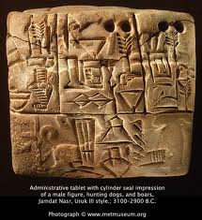
8. Their system of writing was called cuneiform.
9. They used a sharp utensil called a stylus to write in wet clay.
10. They were the first society to put laws into writing.

Slide 5
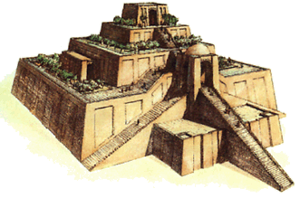
11. The Sumerians believed their gods lived in temples called ziggurats.
12. They built their houses from bricks made out of mud.

