Slide 1
History of the Middle Ages
Video Notes

Slide 2
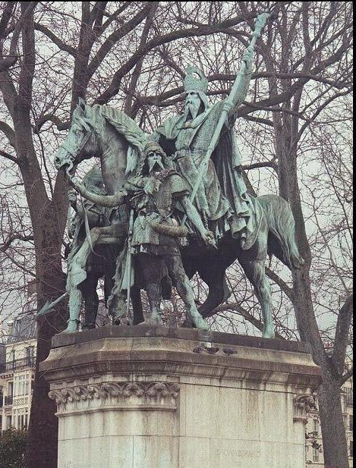
Early Middle Ages 400-900
Charlemagne (Charles the Great) was tall, a great hunter, good father, and known to invite anyone he met to dinner. He was fascinated with learning, so he sat down with schoolboys to hear what their teachers had to say. He was a fearless warrior who personally led his men into battle. Before he died, he said to his people, “Be humble and kind to one another.”

Slide 3
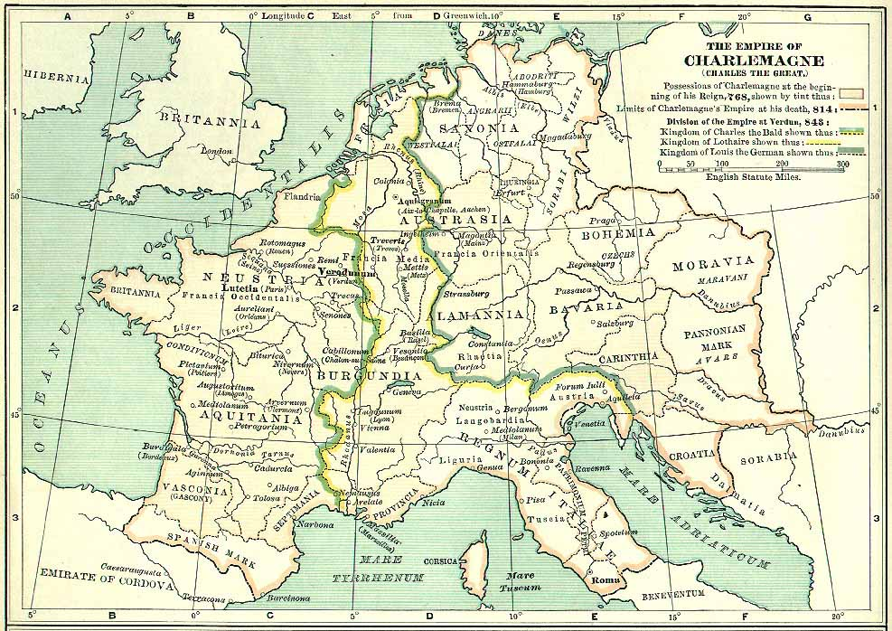
Under the Romans there was unity and a common culture. Without the Romans, Europe was divided into smaller kingdoms often at war with each another.

Slide 4
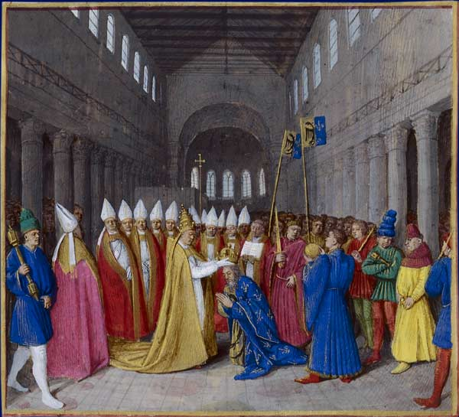
Charlemagne came from the Kingdom of Frank. “Frank” is Latin word which means “free.” Today when we say we want to frankly, it means we want to speak freely or in an open and sincere manner. Charlemagne conquered land and made allies. In the year 800, the pope crowned him emperor. He believed it was a king’s job to care for his people. He gave his lands unified government and provided roads, schools and protection for their trade. When he died in 814, his empire broke into pieces.

Slide 5
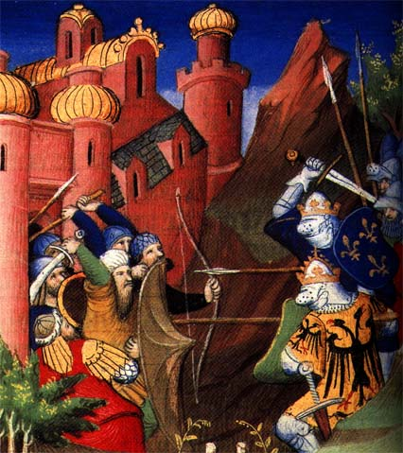
High Middle Ages 900-1250 The Crusades were a series of holy wars fought by Christian soldiers. The first Crusade took place in 1095 because holy sites of the Christian religion were controlled by Muslims in Jerusalem. The pope guaranteed that soldiers in the Crusades would go to heaven with all their sins forgiven. There were a total of 8 Crusades.

Slide 6
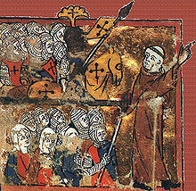
The Crusaders didn’t just bring back loot, they brought back Muslim knowledge about medicine, science, and philosophy. They also brought back the Arabic numerals that we still use today. The Crusades started and ended as a military effort to conquer distant lands, but in between, they became one of the greatest cultural exchange programs in history.

Slide 7
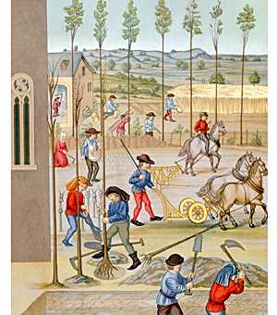
Back home in Europe, things were booming. By the 1100s, people developed new techniques for growing more food in the same amount of space. More food meant less starvation and more people. More people meant more work could get done.

Slide 8
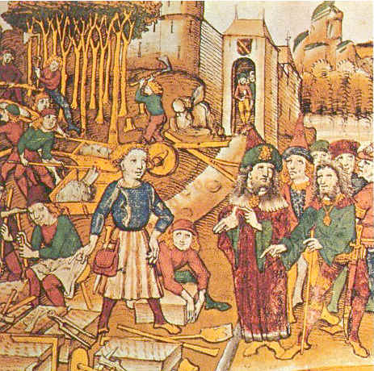
In the towns, merchants hired people to make things. For the first time in the Middle Ages a lot of people, not just the nobility had a little money in their pockets. With money to spend and food to eat, people could put time and energy into making beautiful things.

Slide 9
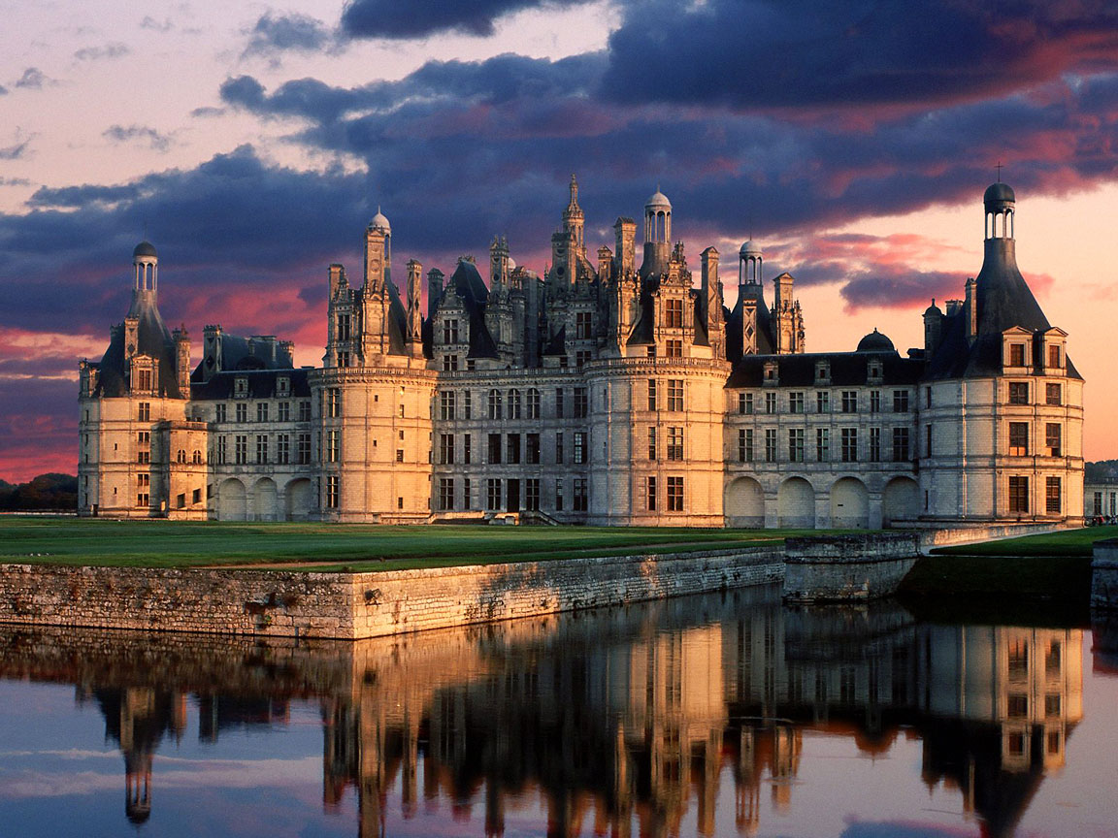
This became the golden age of building cathedrals, chateaux, and castles that were comfortable and defendable. The serfs and peasants worked hard, but since there were good growing seasons, there was always food on the table (until the second half of the 1200s).

Slide 10
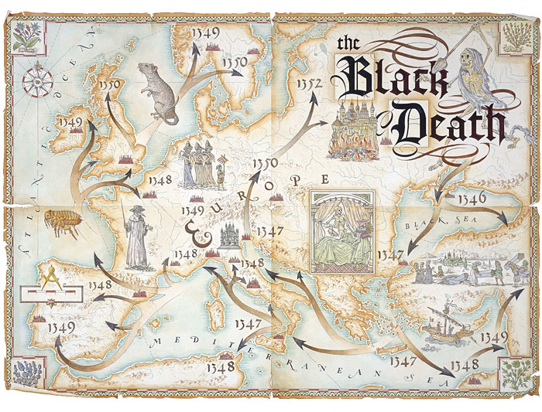
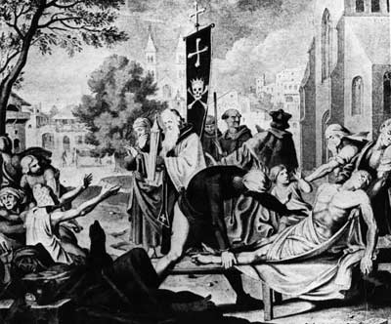
Late Middle Ages 1250-1500
In 1347, a plague called the Black Death came to Europe. In three years, ½ of the people in Europe died. Grain rotted in the fields because there weren’t enough workers to harvest it. The workers that survived tried to demand higher wages and there were rebellions between the peasants and the lords.

Slide 11
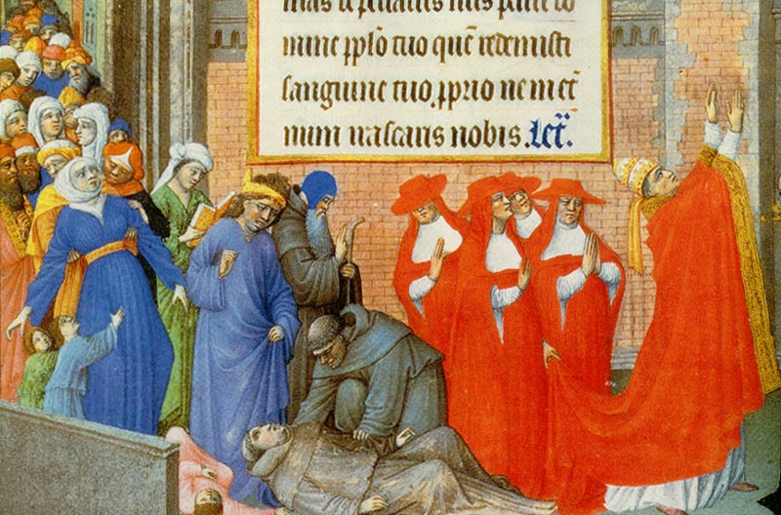
The art of craftsmanship crumbled during the High Middle Ages because many of the craftsmen died and knowledge of their craft died with them. For much of the Middle Ages, church leaders had great power and influence over the people’s lives, but during the Black Death, people saw that church leaders were just as helpless and vulnerable as everyone else. In fact after something as terrible as the Black Death, Europe was never the same.

Slide 12
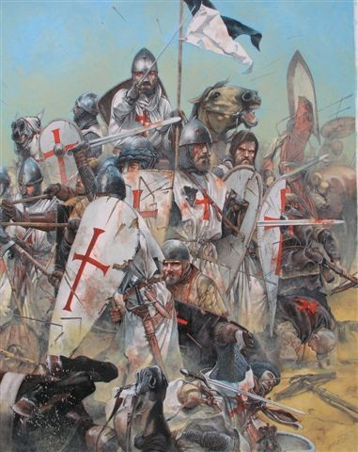
Do you see any contradictions in the life of a crusader?

Slide 13
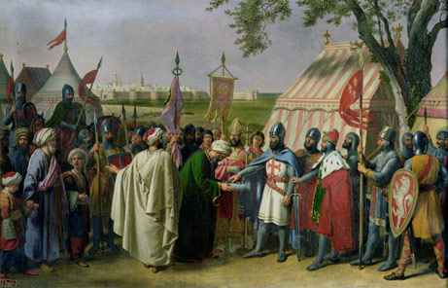
Explain why Saladin’s behavior toward Richard the Lion Heart was considered “true chivalry.”

Slide 14
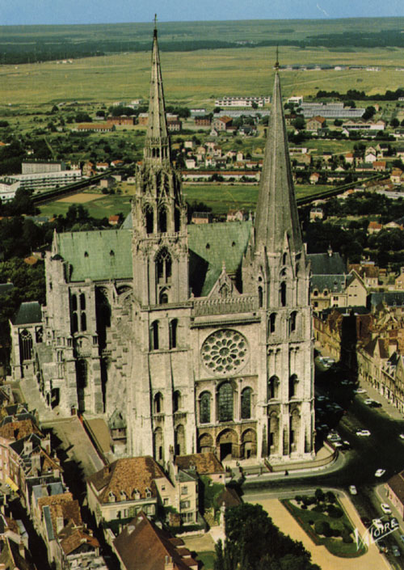
Explain how, in the Middle Ages, surplus of food was connected to the arts. Do you think this connection is still relevant today?

Slide 15
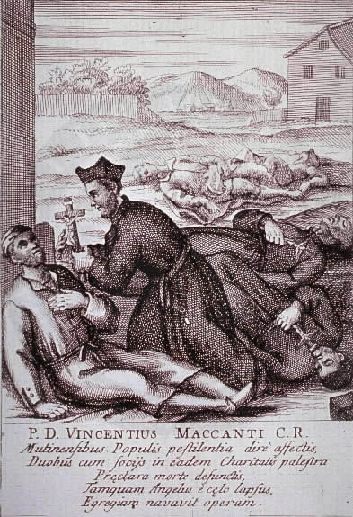
How did the Black Death change people’s view of the church leaders?

