Slide 1
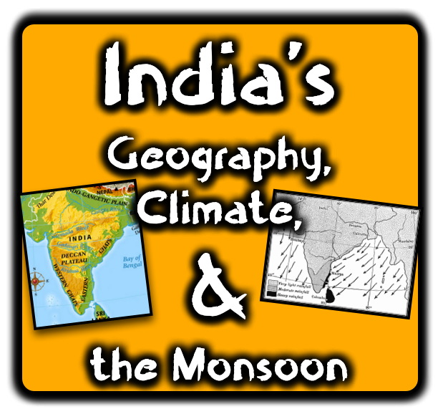

Slide 2
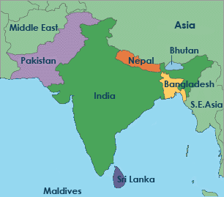
Physical Geography: The Indian Subcontinent
Because it is so large and separated by water from other land areas, South Asia is referred to as a subcontinent. The majority of South Asia is covered by the country of India.

Slide 3
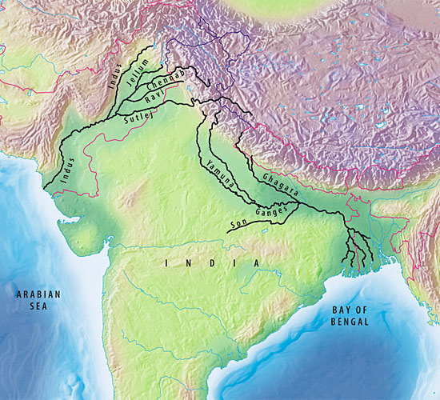
The Rivers
Indo-Gangetic Plain
Indus River
India's two greatest rivers are the Indus and the Ganges. Beginning up in the Himalaya Mountains, they fan out into a wide plain known as the Indo-Gangetic Plain. Monsoon rains cause the rivers to flood and deposit silt, which keeps the soil fertile for farming
Ganges River
Due to the flooding and the silt left behind, soil is very rich here. Also, this has led to the area being very densely populated.

Slide 4
Indus River
WESTERN India
Starts in Himalayas
Empties in Arabian Sea
Ganges River
EASTERN India
Starts in Himalayas
Empties in Bay of Bengal

Slide 5
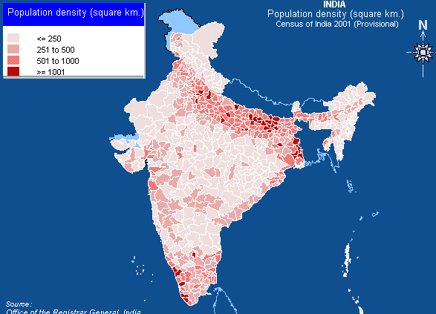
Do you notice the heavily concentrated areas of people in India’s northern and north-eastern sections?
This is a result of the favorable conditions in the Indo-Gangetic Plain!

Slide 6
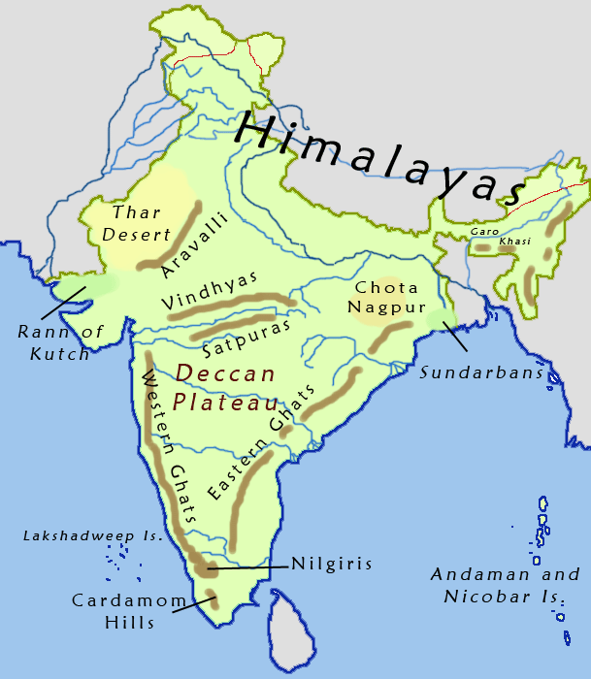
The Plateau
South of the Indo-Gangetic Plain, the land begins to rise. At the same time, it is narrowing towards the southern point of the subcontinent. This region is known as the Deccan Plateau. This area is dryer, so more irrigation is needed for farming. However, the plateau does have very rich volcanic soil which comes from old lava flows.
Notice the Deccan Plateau in central India!

Slide 7
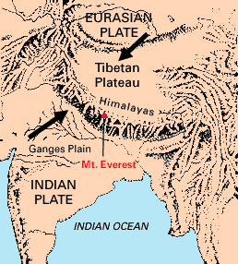
Mountains
The tectonic plate that makes up the subcontinent is pushing into the rest of Asia and created the Himalayas. This massive mountain range is still rising because of this action. Mount Everest, its highest peak, is over 29,000 feet high, the world's tallest.
Do you see how the Indian and Eurasian Plates are pushing against each other? This action is what causes mountains to form – and when you already have mountains, it makes them higher!

Slide 8
India’s southern border has mountains on both sides: the Western and Eastern Ghats!
The Deccan Plateau is framed on either side by rugged mountains, the Eastern and Western Ghats. Each mountain chain runs for over 1,000 miles. The forests that cover much of these mountains are home to a variety of wildlife.

Slide 9
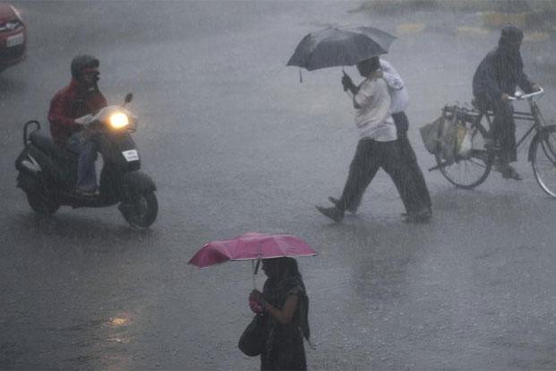
Climate
India’s climate is dominated by monsoons. Monsoons are strong, often violent winds that change direction with the season. Monsoons blow from the sea toward land in the summer and from the land toward the sea in winter.
People often associate monsoons with severe rain storms, like the one above. However, a monsoon only refers to violent wind that changes direction with the season. There are dry monsoons too!

Slide 10
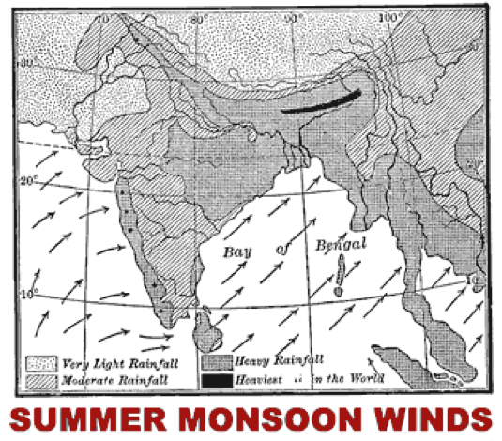
India’s Summer Monsoons
In the summer, air current travels across India from the southwest. The current brings moisture from the Indian Ocean and drops it over India, causing heavy rainfall at times. Because of this, the summer monsoon is the wet monsoon in India.
The summer monsoons roar onto the subcontinent from the southwest. The winds carry moisture from the Indian Ocean and bring heavy rains from June to September. The torrential rainstorms often cause violent landslides. Entire villages have been swept away during monsoon rains.
Monsoons of India

Slide 11
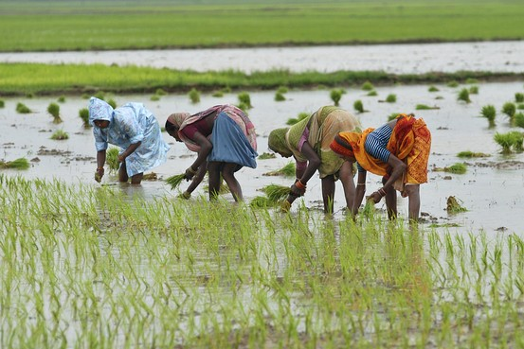
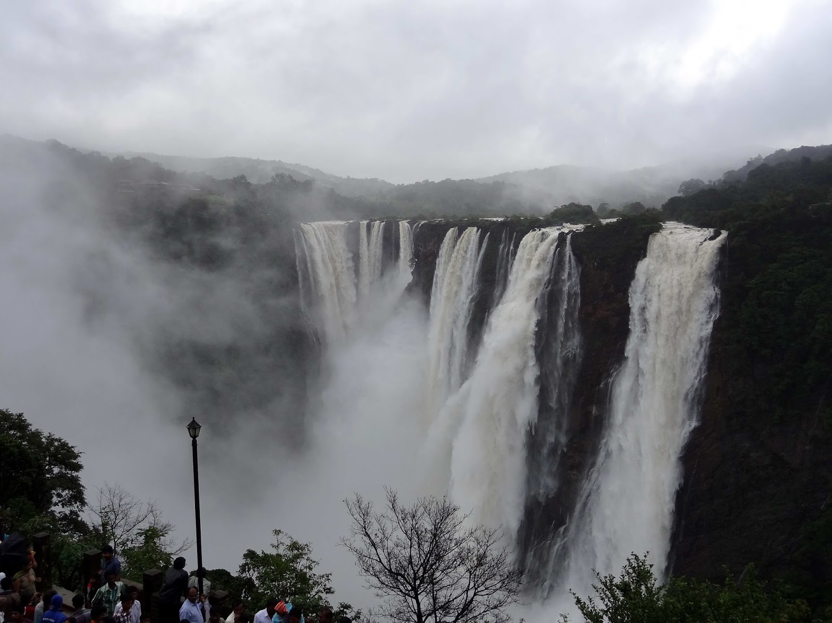
India’s Summer Monsoons
The summer monsoon brings much-needed rainfall for crops!
Despite the potential for destruction, the summer monsoons are welcomed in India. Farmers depend on the rains to irrigate their land. Additionally, a great deal of India’s electricity is generated by water-power provided by the monsoon rains.
The water power provided by the monsoon gives hundreds of thousands access to electricity!

Slide 12
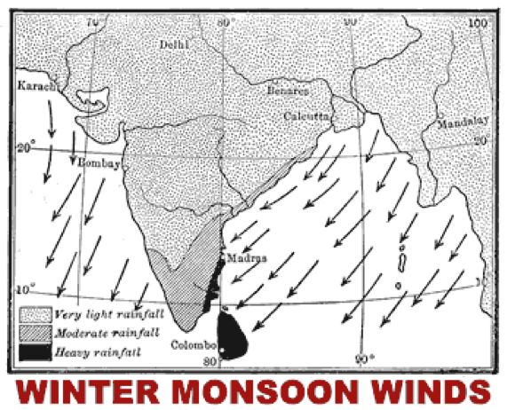
India’s Winter Monsoons
In the winter, air current reverses and travels across India from the northeast. Most of the water vapor falls in the massive Himalayan Mountains, which then brings dry air into India. Because of this, the winter monsoon is the dry monsoon in India.
India’s winters are hot and dry. The monsoon winds blow from the northeast and carry little moisture. The temperature is high because the Himalayas form a barrier that prevents cold air from passing onto the subcontinent.

Slide 13
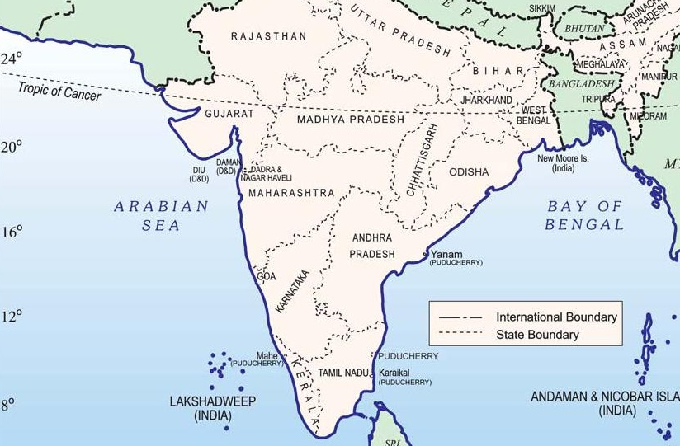
India’s Winter Monsoons
Notice the Tropic of Cancer which runs through north-central India. This means India is very warm year-round!
Additionally, most of India lies between the Tropic of Cancer and the equator, so the sun’s rays shine directly on the land. The temperature can reach as high as 110 degree (F) during the Indian winter.
Watch how monsoons work!

