Slide 1
Introduction to Social Structures Unit

Slide 2
Warm up: On a clean sheet of paper, answer the following questions the best you can. Take an educated guess if you are not certain.
What do you think social structure is?
What are some factors today that might affect a person’s social structure?
Do you think there are social structures existing in the U.S. today? If so, name an example.

Slide 3
Click here to get to Discovery Ed video:
https://app.discoveryeducation.com/learn/videos/5f164888-f161-4838-9766-f42ad1fc0470/
After the video plays, you will take a few notes on Social Structure and social hierarchies. These notes will go on the same page as your warm-up.

Slide 4
Social Structure- Copy these notes!
Social structure is the way in which people are organized in any given civilization.
In ancient civilizations and in some today, people are ranked as more powerful than others based on multiple factors. These can change from region to region.
Name some factors that affect a person’s status.
Money, jobs, religion, race, ethnicity, gender, age

Slide 5
Social structure may not be that noticeable in America but in other regions it dictates day to day life.
Every civilization has a social structure- even if it is just upper class, middle class, and lower class determined by income.

Slide 6
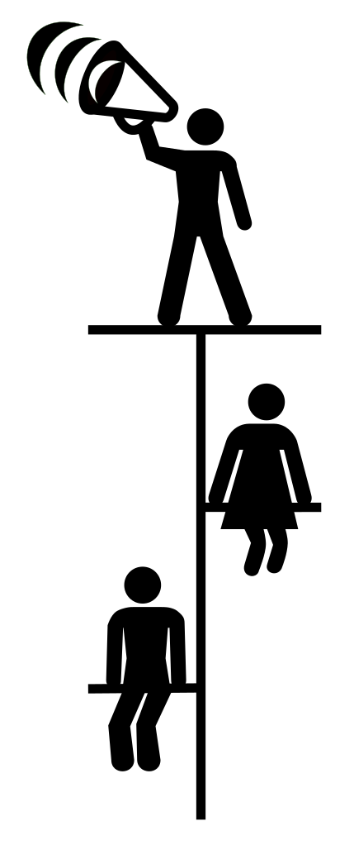
Hierarchy
~a system or organization in which people or groups are ranked one above the other according to status or authority.

Slide 7
On this same notes page, I want you to think about the following question in answer in 3- 5 sentences (complete sentences).
Explain why you think MPMS does or doesn’t have social hierarchies and provide examples to support your answer.

