Slide 1
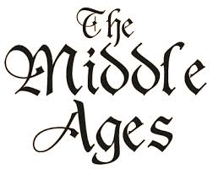

Slide 2
Main idea #1: The word feudal refers to feudalism, the economic, politcal and social system that characterized medieval Europe from about 1000 – 1300.

Slide 3
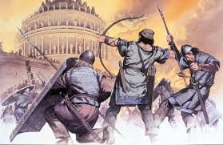
Main idea #2: After the fall of Rome, western Europe descended into a period of instability known as The Dark Ages.

Slide 4
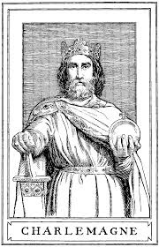
Main idea #3: Charlemagne became the first Holy Roman Emperor, stabilizing western Europe.

Slide 5
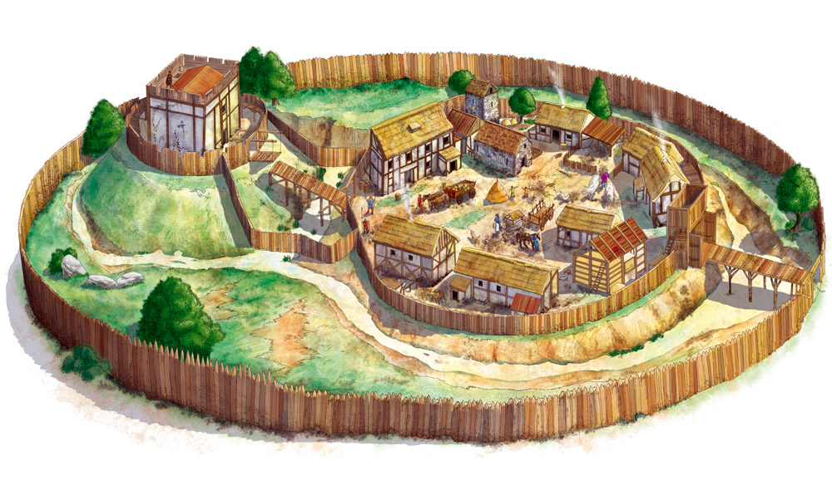
Main idea #4: After Charlemagne’s death there was no central government to provide protection to kingdoms led to the development of feudalism.

Slide 6
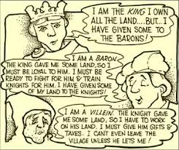
Main idea #5: Vassals received land from kings, dukes and nobles in exchange for their services in battle and other duties.

