Slide 1
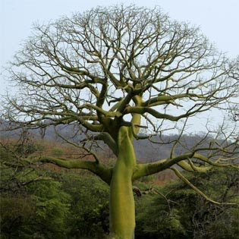
MAYA
Date of Existence | 2000 BCE- 1542 CE
Location of Group | Yucatan Peninsula/ Mexico
Fun Fact | Pyramids were painted in red. Pok-a-tok was a popular sport played
Religion | a. Believed the Ceiba tree to be the center of the Earth During Mayan ritual ceremonies, Mayans would fast, drink alcohol, perform bloodletting, and visit shrines and temples to worship gods. Pok-a-tok relates to the Mayan’s religion because the losing team would be sacrificed to the gods making the winning team look good to the gods.

Slide 2
AZTEC
Date of Existence | 1350-1521 CE
Location | Central Mexico on Lake Texcoco
Fun Fact | The symbol in the middle of Mexico’s flag is the eagle perched on the cactus representing the myth of the founding of Tenochtitlan. Chocolate was a drink enjoyed by the Aztecs.
Religion | a. Aztecs believed human blood made the gods happy b. Priests were important for interpreting messages from gods and possessed the sacred calendar surrounding planting and harvesting schedules. c. The Aztecs believed the sacrificial victim was a messenger being sent to the gods. d. The purpose of the flying dance ritual was to please the god of fertility so he would send rain and provide for good agriculture. e. The Aztecs got most of their sacrificial victims by capturing them in wars. Some people volunteered as an honor.

Slide 3
INCAS
Dates of Existence | 1100AD -1532 AD
Location | Andes mountains in South America
Fun Fact | The Incas has roads and built rope bridges. Incas introduced the coca leaf and potatoes to the world.
Religion | a. The Inca priests taught the rest of the Incas about the gods, heard their confessions and gave penance (forgiveness). b. The Incas believed their ruler to be related to Inti, the sun god. c. There is evidence of religious places, mummies, all homes had religious statues. d. Both Incas and Egyptians mummified their dead and both believed the king or pharaoh to be a god or representative of the gods. e. Crops, cloth, and llamas were all used as sacrifices to the gods.

