Slide 1
Origins of Judaism

Slide 2
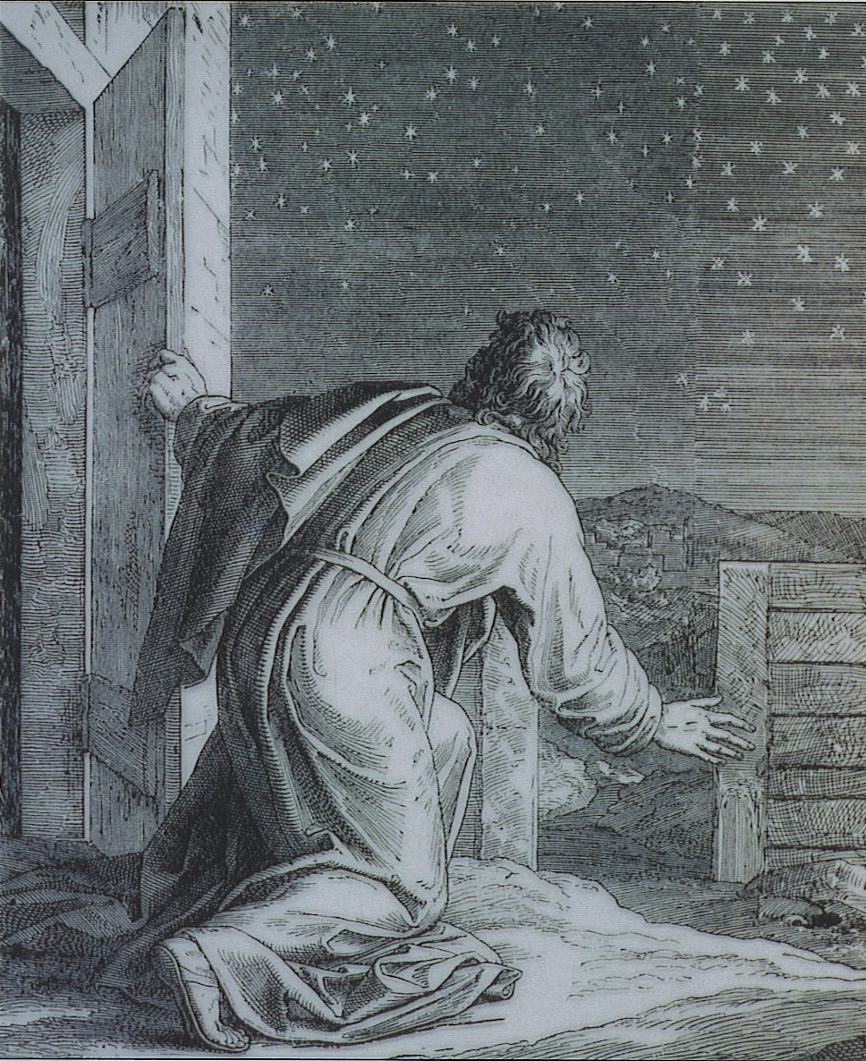
A. God’s Covenant with Abraham
God asked Abraham to leave Mesopotamia and take his family to Canaan. God expected Abraham and his people to devote themselves to God and God promised to protect them. Abraham’s descendants would be called the Israelites and eventually their nation would be called Israel.

Slide 3
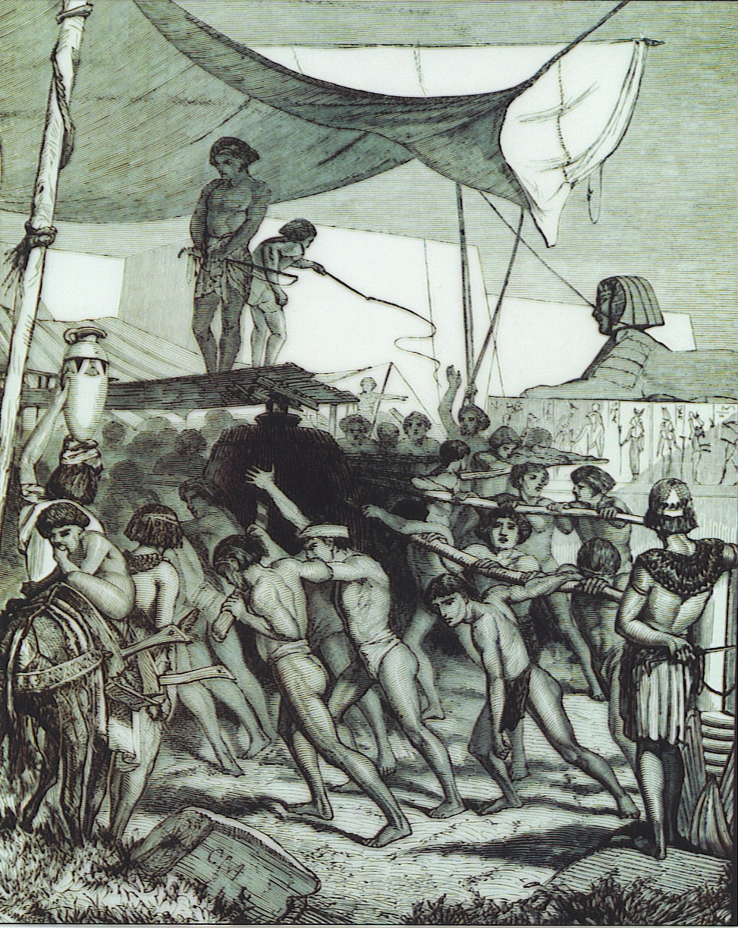
B: The Enslavement of the Israelites
Jacob and his entire family move to Egypt to avoid the famine in Canaan. Joseph (Jacob’s son) became so powerful in Egypt because he interpreted a dream for the pharaoh which helped to prevent a famine. The Israelites were growing in population in Egypt and King Ahmose decided to enslave the Israelites because he feared they would get too powerful and try to wage war against the Egyptians. He also required that newborn male babies be killed however Moses was one male baby who escaped this fate.

Slide 4
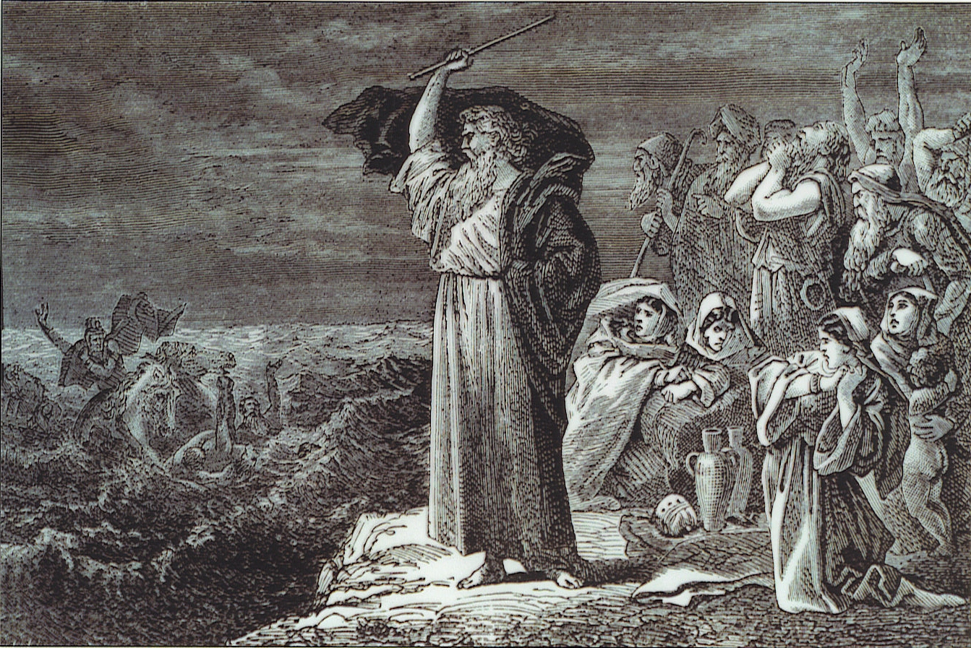
C: The Exodus from Egypt
According to the Torah, Moses escaped death in Egypt because his mother placed him in a basket in the Nile river for him to float away. God told Abraham to return to Egypt and lead the Israelites out of slavery and back to Canaan. Moses told his people that God would take care of them and when they reached the Red Sea, God parted the waters so they could walk across. The Israelites believed this to be a miracle and God’s promise to keep them safe, so they have a new faith in God.

Slide 5
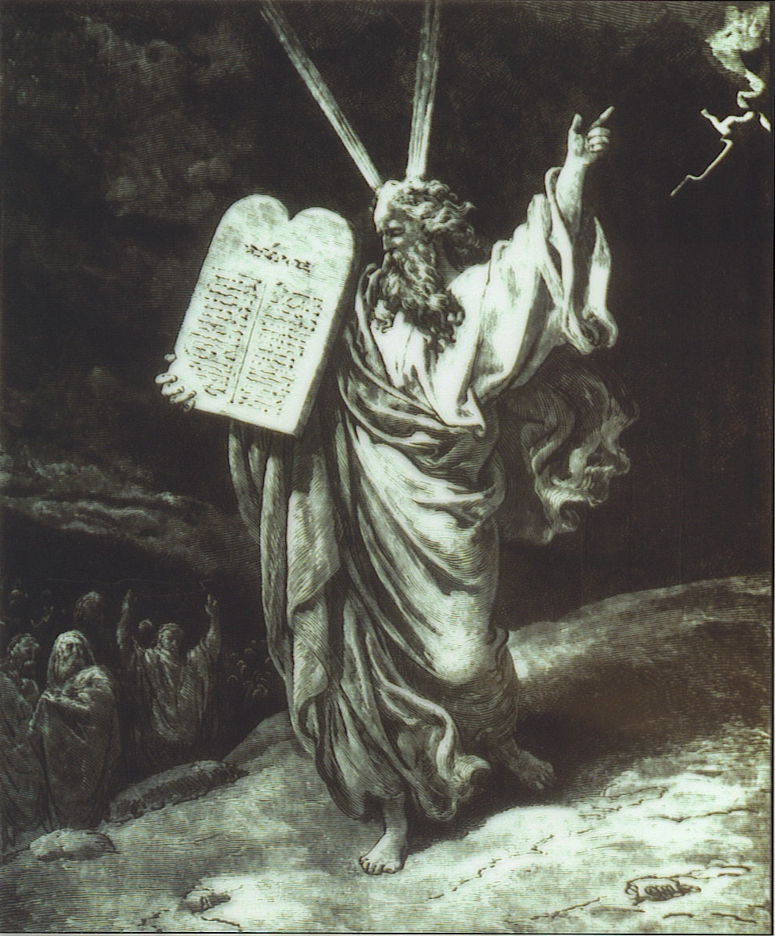
D: Moses Receiving the Ten Commandments
After leaving Egypt and crossing the Red Sea, the Israelites went west to Mount Sanai. At Mount Sanai, Moses received the Ten Commandments from God. He shared the Ten Commandments with the Israelites and then they continued traveling to Canaan.

Slide 6
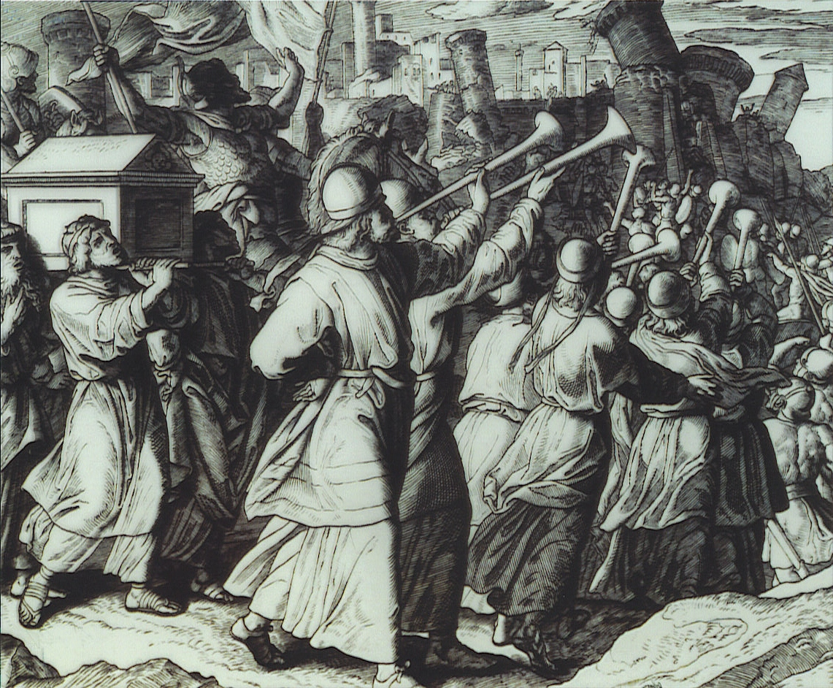
E: Joshua’s Conquest of Jericho
Approaching Canaan the Israelites begin to doubt God and Moses because there is already others living where they thought they were going to live. God became mad at their lack of faith in him and ordered them to live in the wilderness for 40 years. Once the Israelites return to Canaan, they circle the city of Jericho and eventually break down the walls of the city, making their way in to their new homeland. This new nation is called Israel and is where Judaism has its roots.

