Slide 1
Primary and Secondary Sources

Slide 2
Definitions
A primary source is an account created by someone who participated in or witnessed an event.
A secondary source is an account created by someone who researched and analyzed primary sources. It is one or more steps removed from a primary source.
Primary Source
Secondary Source

Slide 3
Pros and Cons
Primary Source
Secondary Source
Pros:
1. Provide vivid details
2. Reveal emotions
3. Can reveal values
4. Allow readers to make
their own judgments
5. Can give history a more
personal feel
Pros:
1. Provide expert analysis
2. Blend points of view
3. Can be more objective
4. Easier to find and read
5. Can give history a more
professional feel
Cons:
1. Errors are less likely to be
discovered.
2. Personal bias is more likely
3. Harder to find
4. Harder to read – outdated
vocabulary, reading level,
language
Cons:
1. Tend to be dull
2. Bias can be more subtle and
harder to detect.
3. Removes the reader from
source material.
4. Can give the impression
that there is only one way
to interpret history.

Slide 4
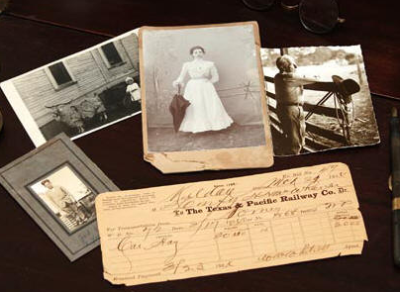
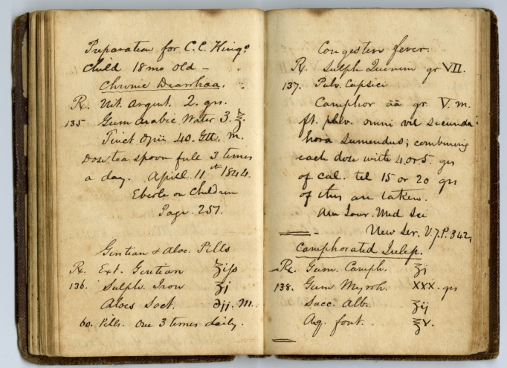
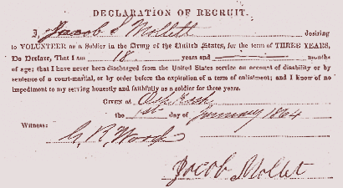
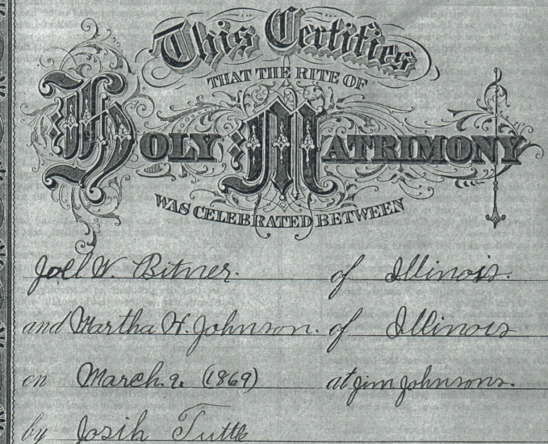
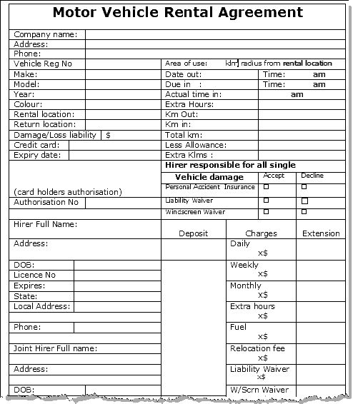
Examples of Primary Sources
Documents and Photos
Diaries and Journals
Newspaper Articles
Government Records
Personal Documents
Contracts

Slide 5
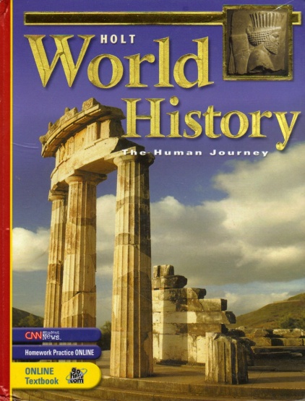
Examples of Secondary Sources
Encyclopedias
Textbooks
Biographies

Slide 6
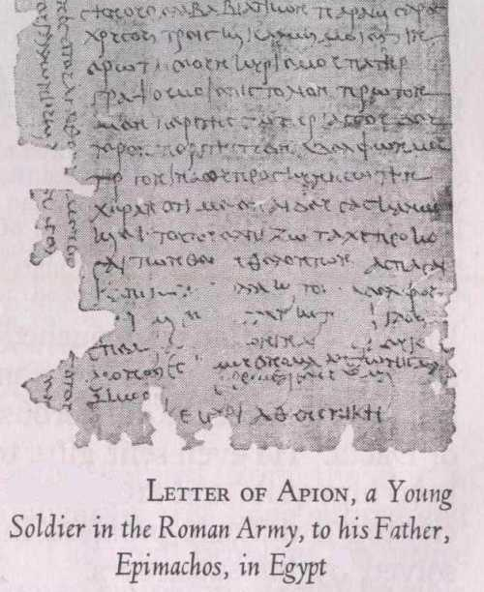
Primary Source – an example
Apion to his father and lord Epimachos: Many good wishes! First of all I hope you are in good health and that things are going well for you and my sister and her daughter and my brother. I thank the Lord Serapis [an Egyptian god] for saving me right off when I was in danger at sea. When I arrived at Misenum [the Roman war harbor, near Naples], I received three gold pieces from the Emperor [Trajan?] as road money, and I’m doing just fine. Please write me a line, my lord father, about your own well-being, second about that of my brother and sister, and third so that I may devotedly greet your hand, because you brought me up well and I may therefore hope for rapid promotion, the gods willing. Give my regards to Capiton [some friend] and my brother and sister and Serenilla [a family slave?] and my friends. I’m sending you my little portrait through Euktemon. My [new]Roman name is Antonius Maximus. All my best!

Slide 7
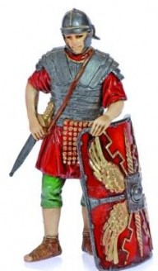
Assignment – Primary vs. Secondary Sources – Part 1
Read the full text of the letter from Apion to his father Epimachos.
List two passages in the letter that gave you an understanding of the feelings or emotions of the writer.
Describe one way that you preferred the letter.
Describe one way that you preferred the article.
4. Write a one paragraph response to one of the following prompts:
a. History books should include only
primary sources.
b. History books should include only
secondary sources.
c. History books should include both
primary and secondary sources.
3.
Answer these questions:
1.
2.
Read the article titled “Roman Soldiers” .

Slide 8
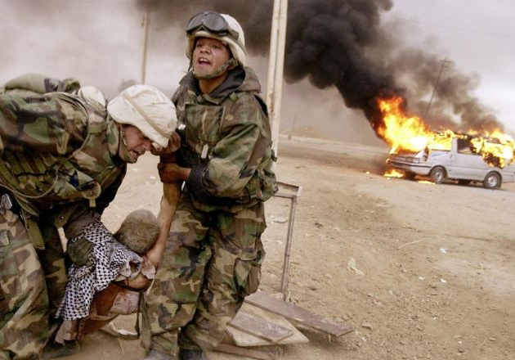
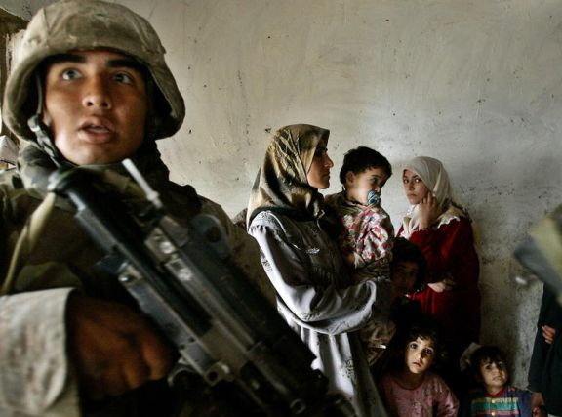
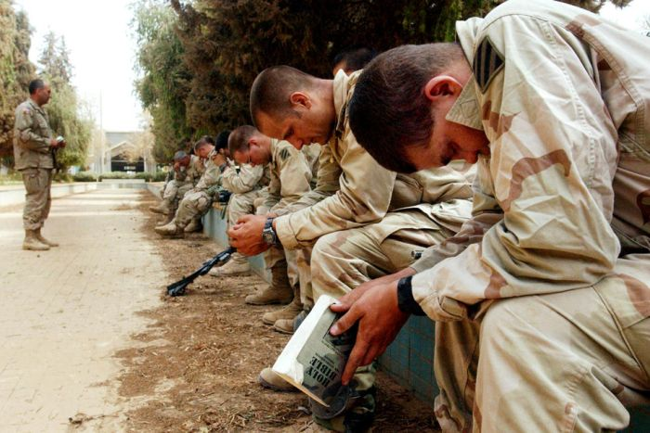
Assignment – Primary vs. Secondary Sources – Part 2

Slide 9
Do parts A and B below.
A
After examining the photographs on the previous slide, do #1, and #2 or #3:
1. List two adjectives for each photograph, then use those adjectives in #2 and #3 below.
Take the role of a person shown in one of the photographs and write a letter home to a
relative describing that day.
Take the role of a person shown in one of the photographs and write an imaginative journal entry for that day.
B
Write a letter to an American soldier serving in Iraq or Afghanistan. Include the following:
the date
your first name and age
your grade and the name of our school – Daniels Middle School, Raleigh NC
an expression of gratitude (thanks) for his or her service to our country
a mention of Veteran’s Day
your thoughts on one or more of these topics: TV, movies, sports, music
a follow up question about the same topic(s)

