Slide 1
Explain how the Rosetta Stone helped solve the meaning of hieroglyphs

Slide 2
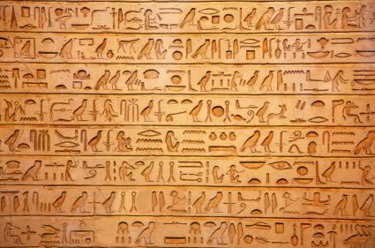
How can we read this?

Slide 3
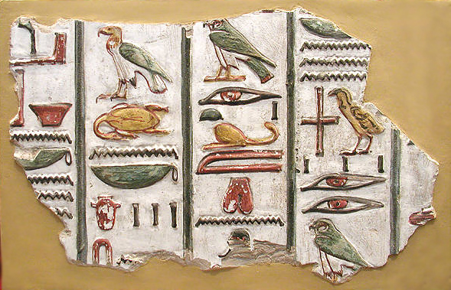
When people outside of Egypt discovered the large amount of picture writing called ‘hieroglyphs’, they spent years trying to figure out what the ancient Egyptians were saying. Many professionals devoted almost their entire lives to making an attempt at translation. Try as they might, they just couldn’t decipher it. It wasn’t until the Rosetta Stone was found, that they had a way to read the messages of the ancient Egyptians.

Slide 4
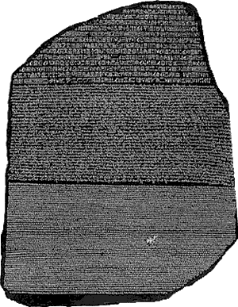
What is the Rosetta Stone?
The Rosetta Stone was actually found by one of the soldiers in Napoleon’s army in 1799. Napoleon was fascinated with ancient Egypt and spent a lot of time there with plans to rebuild a fort. While they were digging around in some of the foundations at a town called el-Rashid (which means Rosetta) they found the stone which has two different languages: hieroglyphic and Greek and using three different types of script. The third script was demotic, which was commonly used in Egypt. When the British defeated Napoleon, the stone became the property of the British and was taken to England and then to the British Museum.

Slide 5
An English physicist named Thomas Young figured out that some of the hieroglyphs sounded like a royal name.
It wasn’t until a French Scholar, by the name of Jean-Francois Champollion took interest that he realized this was the same message in two languages.

Slide 6
The Rosetta Stone Carved on Granite Stone 2 Languages (Greek and Hieroglyphs) Jean-Francois used his knowledge of Greek to solve the meaning of the writing. He was able to decipher the code and in 1822 he managed to translate two of the names of the pharaohs: Ramesses and Thutmose

Slide 7
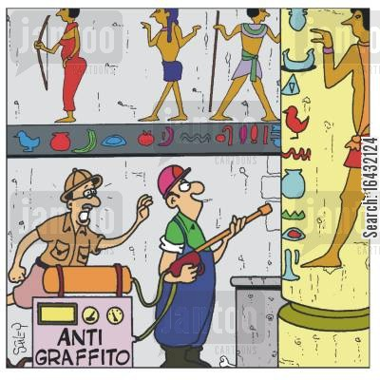
The Rosetta Stone became the ‘key’ to unlocking the door to the messages and writings found in so many areas of Egypt. From that point on, everyone began understanding the hieroglyphs and realized how incredibly smart the ancient Egyptians were.

